Slide 1
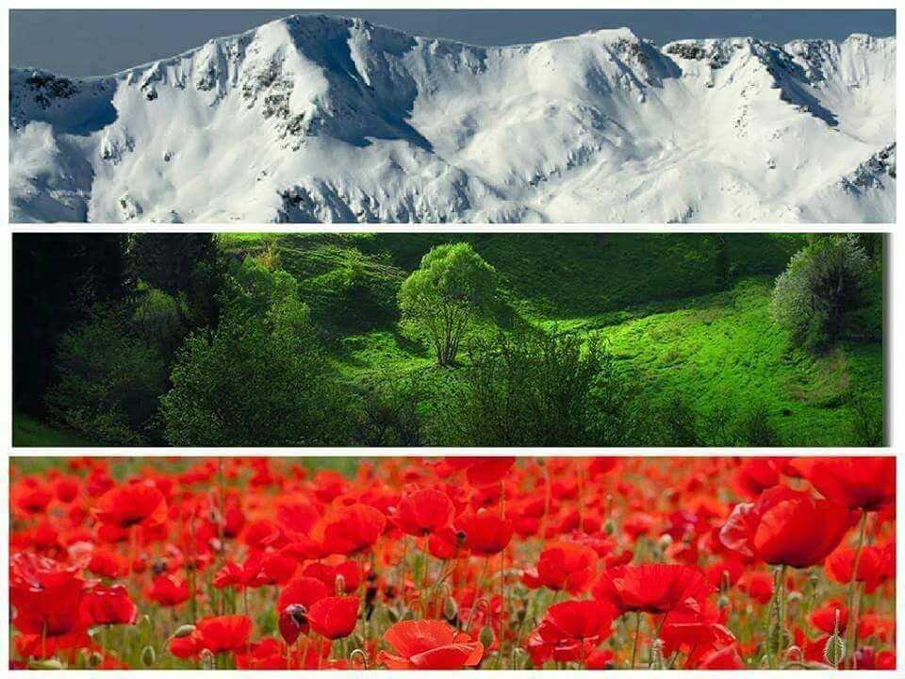
This is Bulgaria

Slide 2
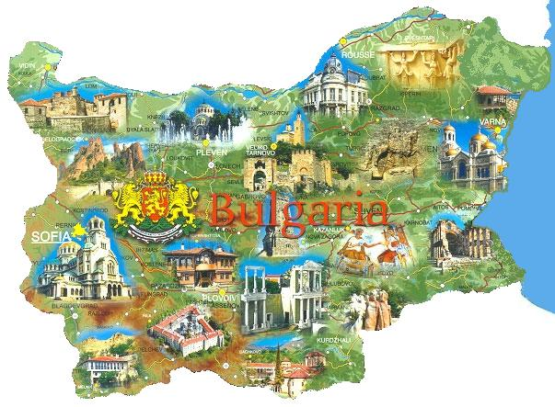
Bulgaria is in Europe.
It is located on the Balkan Peninsula.
Location

Slide 3
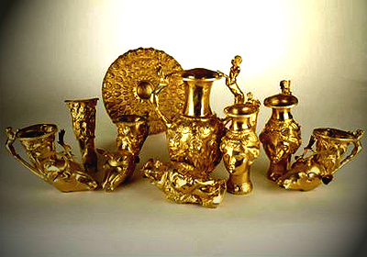
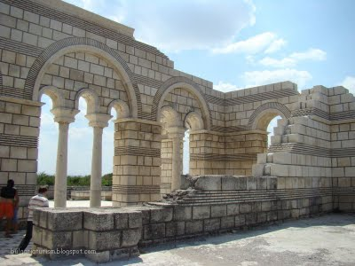
Bulgaria was founded in 681. It is one of the oldest countries in Europe.
Pliska was the first Bulgarian capital.
History

Slide 4
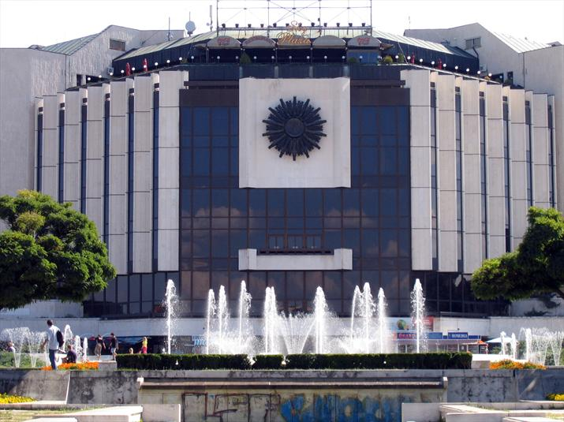
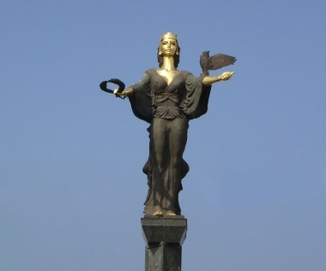
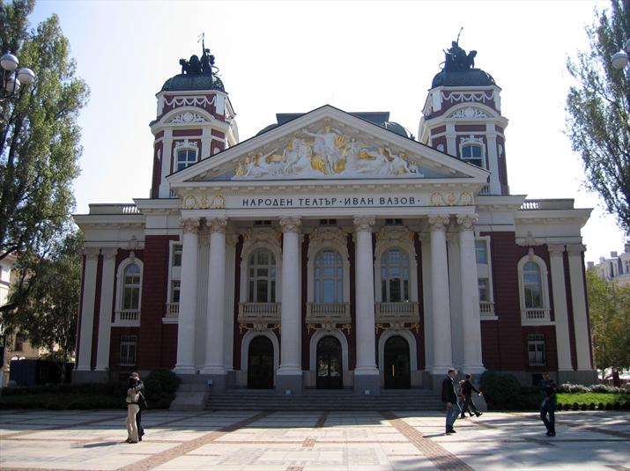
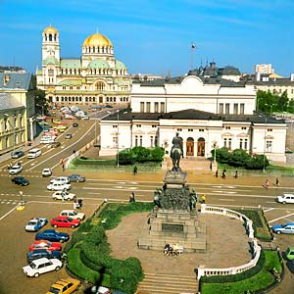
Sofia is the capital of Bulgaria. Sofia is an ancient city with a rich history. The city was founded by a Thracian tribe 3000 years ago.
Capital

Slide 5
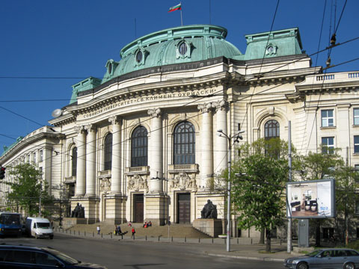
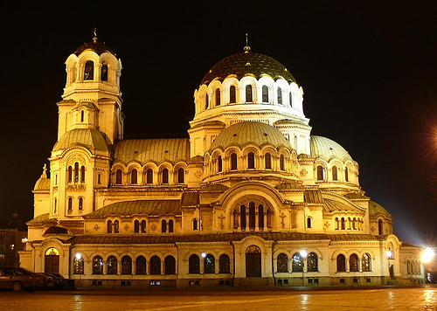
There are a lot of museums, universities, theatres, monuments, famous buildings and parks.
The Alexander Nevski Cathedral is the biggest church in Bulgaria.
Capital

Slide 6
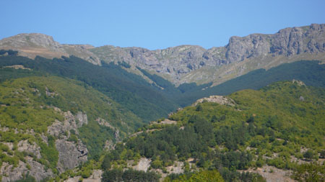
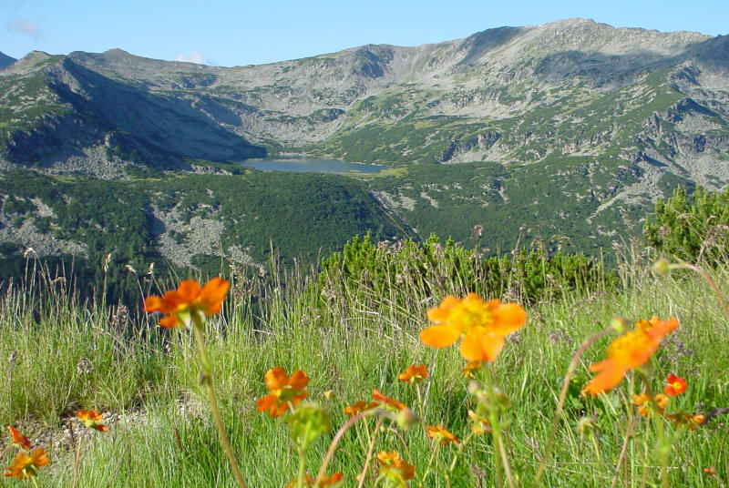
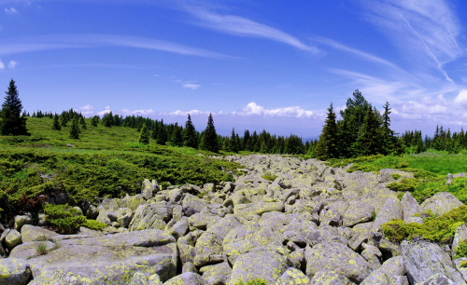
The Balkan Mountains is the longest mountain in Bulgaria.
The Rila Mountain is the highest mountain in Bulgaria.
Vitosha Mountain is a beautiful national park. It rises above Sofia and it is one of the symbols of our capital city.
Mountains

Slide 7
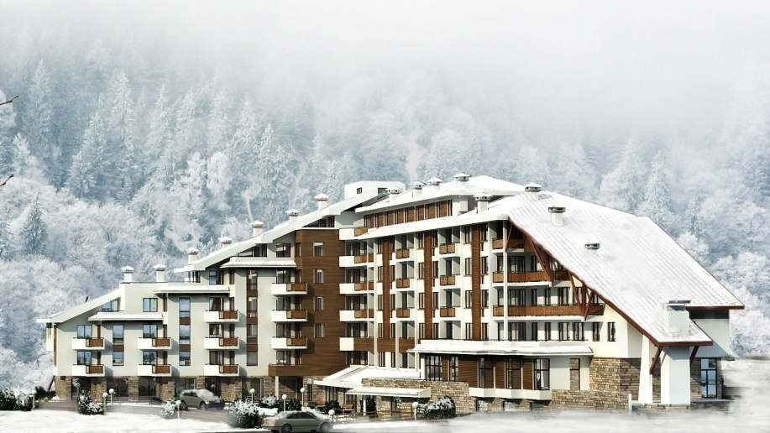
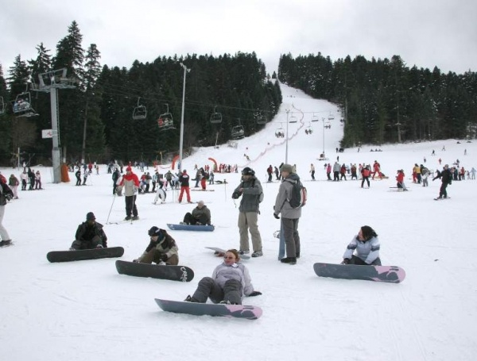
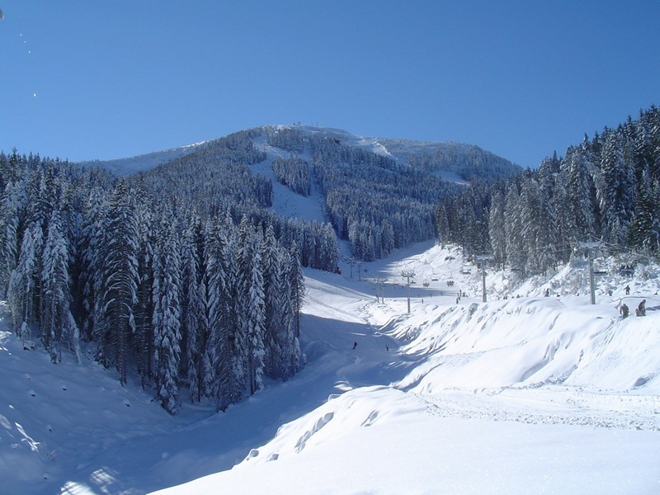
Pamporovo, Borovets and Bansko are modern ski resorts. They are the sunniest mountain resorts with wonderful snow in winter.
Mountain resorts

Slide 8
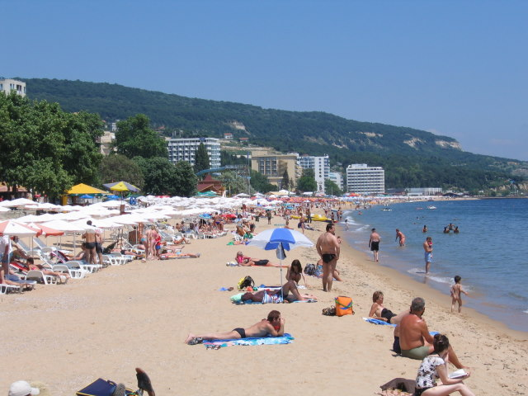
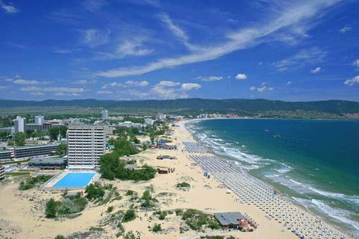
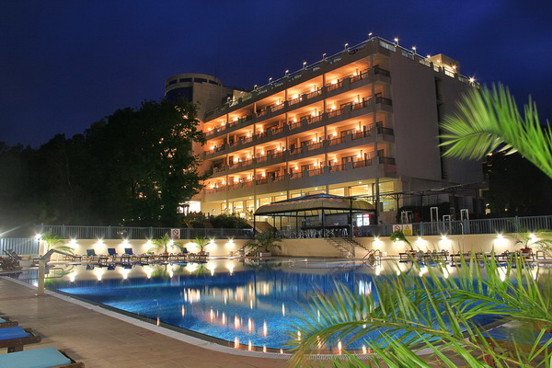
You can see large beaches and beautiful rocky shores along the Black Sea coast.
Golden Sands, Albena, Sunny Day, Sunny Beach are the most famous sea resorts.
Sea resorts

Slide 9
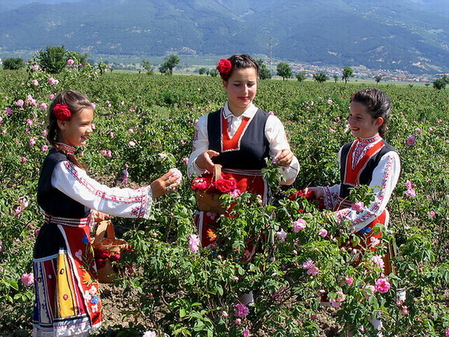
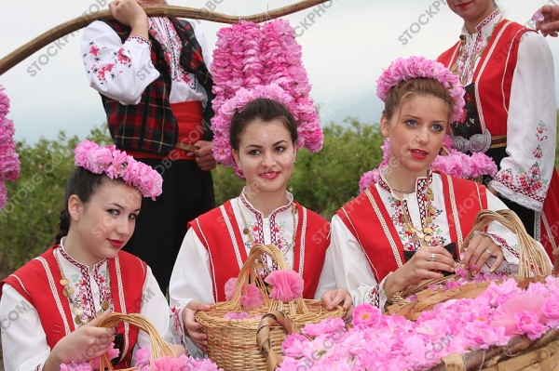
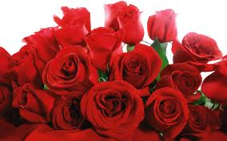
The Valley of the roses is one of the most romantic places in Bulgaria.
The red rose is the symbol of Bulgaria.
The Rose Valley

Slide 10
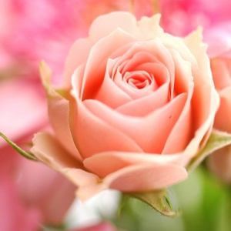
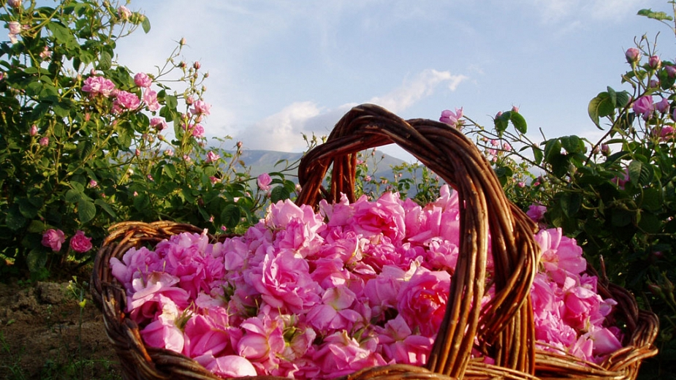
The Organic Bulgarian Rose Oil, obtained by steam distillation has one of the most valuable and distinct fragrances. Rose oil is widely used in the cosmetics and the perfume industry. Bulgaria is the second world producer of Rose oil.
Rose oil

Slide 11
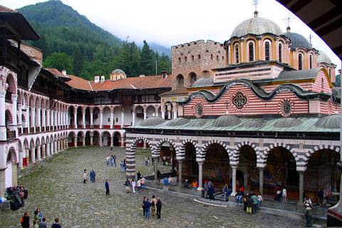
There are more than 140 monasteries in Bulgaria.
Rila Monastery is the best-known. It was established in 10th century.
Monasteries

Slide 12
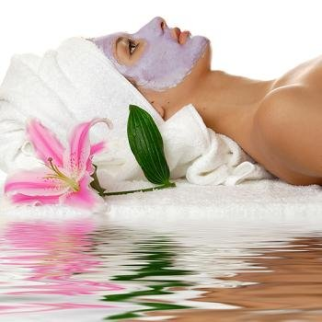
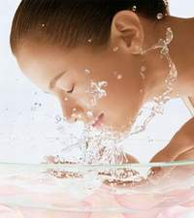
Bulgaria is an extremely attractive center for treatment, recreation and tourism with its numerous resorts, nice climate, wonderful beaches and over 500 mineral springs.
Country of health

Slide 13
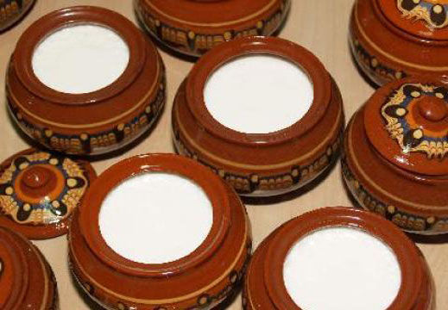
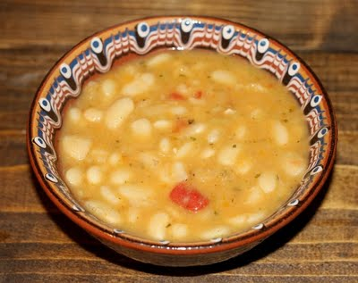
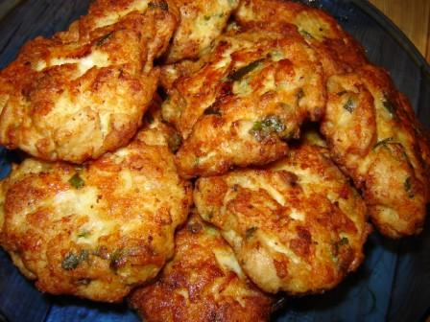
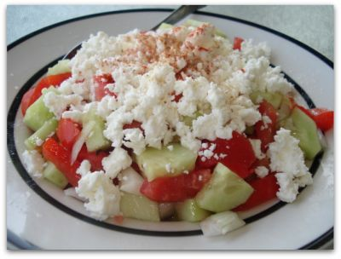
Bulgarian food is delicious. Here are some typical national dishes:
Bulgarian yoghurt is the best in the world.
Bean soup is very popular.
Bulgarian people love to eat meat balls and shopska salad.
Food

Slide 14
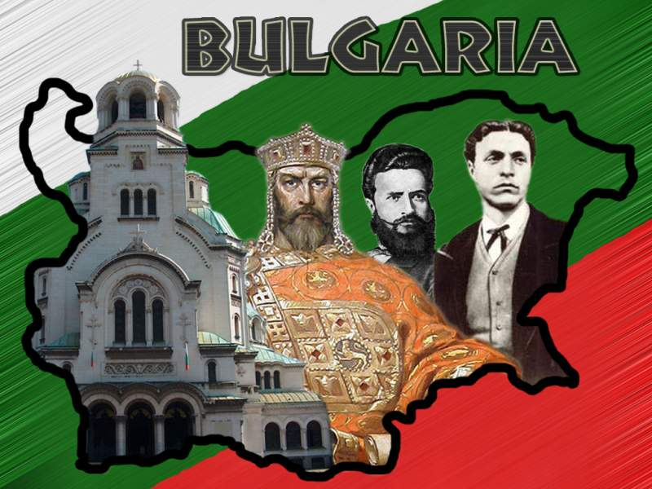
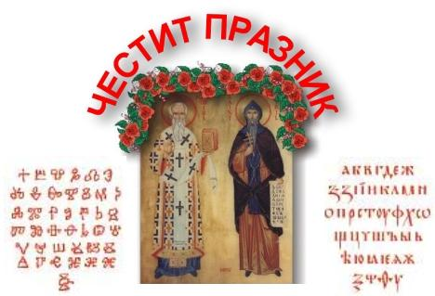
The Bulgarian national holiday is on the 3rd March. We celebrate the liberation from Ottoman rule.
On 24th May we celebrate the Day of the Bulgarian alphabet.
Holidays

Slide 15
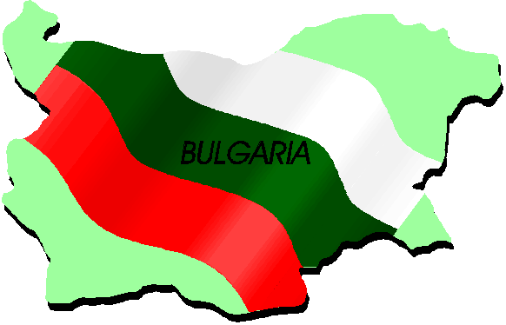

KRESNA
Kresna, Bulgaria

Slide 16
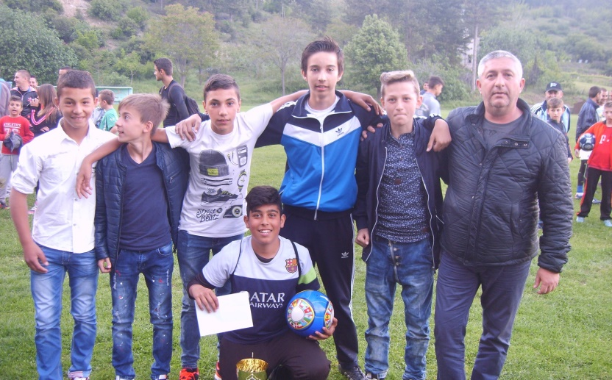
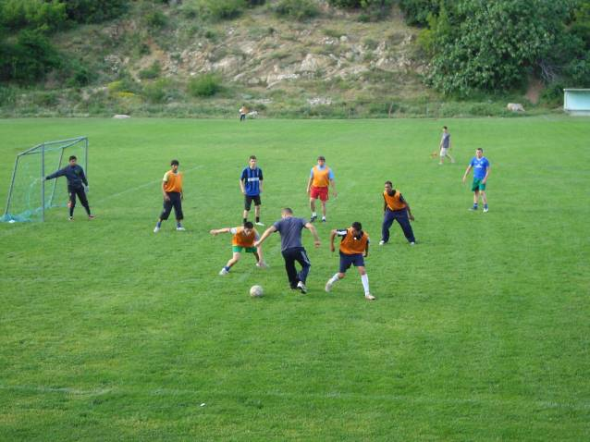
Sports activities are the most popular among young people in the Municipality of Kresna.
We practice football, basketball and handball as all young people all over the world.
Young people and sport

Slide 17
BUT… OUR NATURE GIVES US MORE OPPORTUNITIES!
Young people and sport

Slide 18
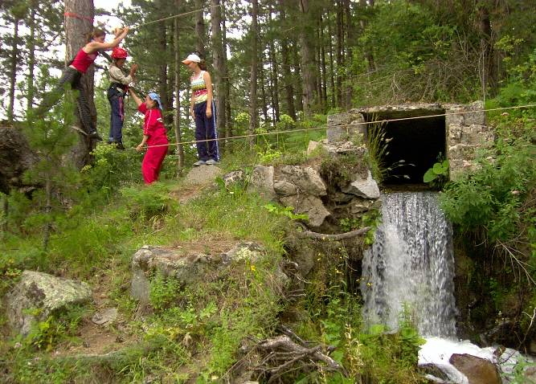
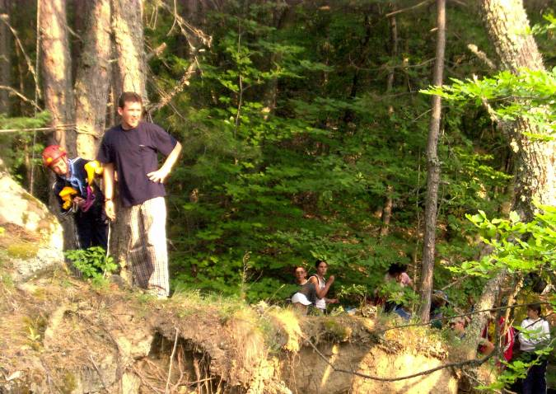
Kresna is located in the bosom of the Pirin National Park
Hiking, rock climbing, sport hunting and fishing are attracting more and more people to the mountain.
Pirin National Park

Slide 19
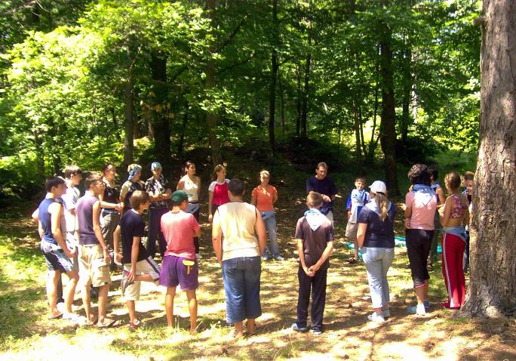
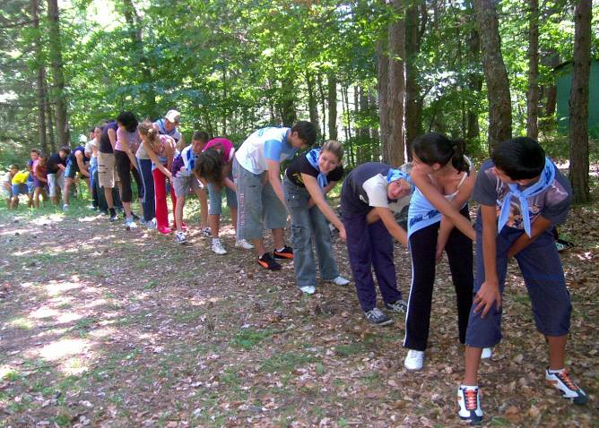
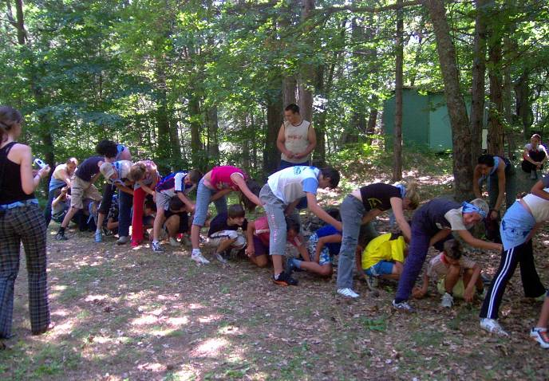
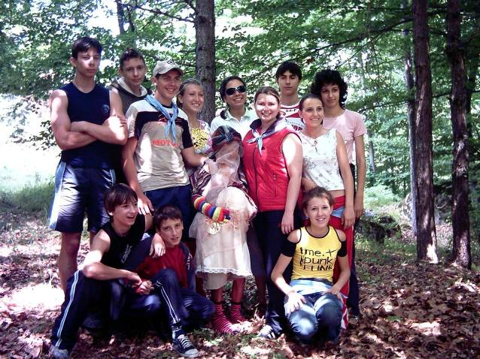
Mountain sport activities

Slide 20
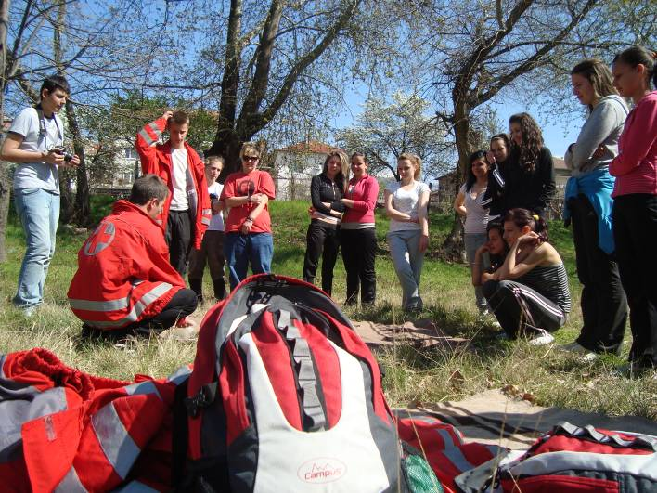
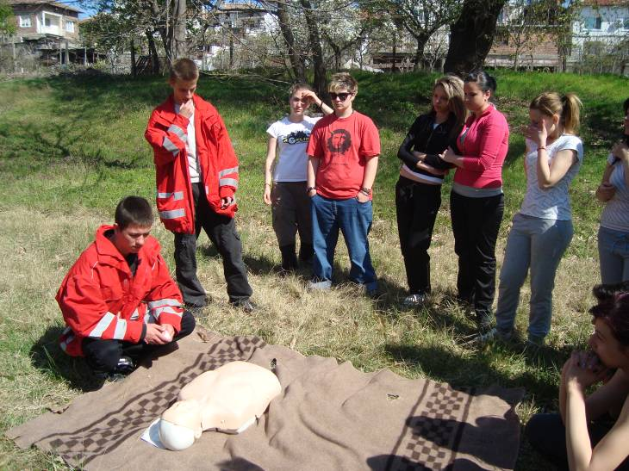
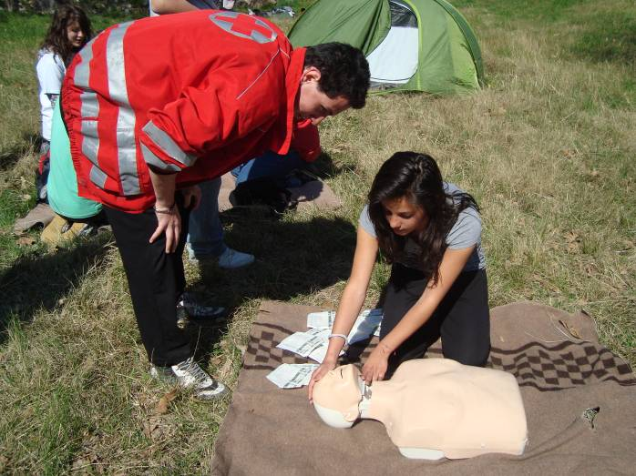
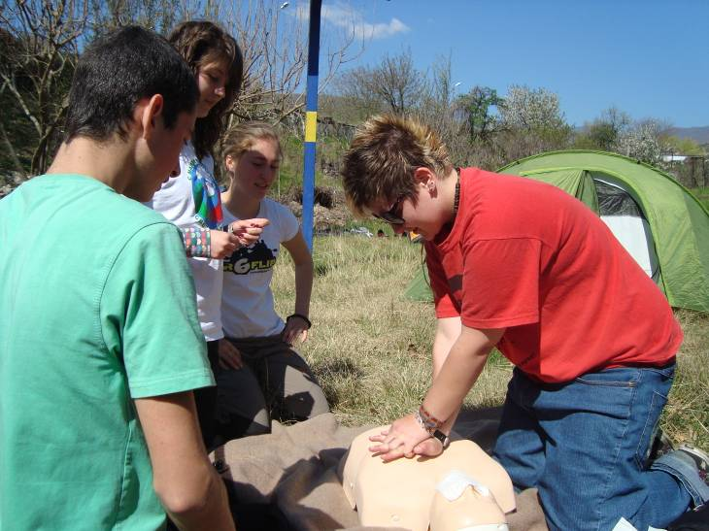
We learn how to survive

Slide 21
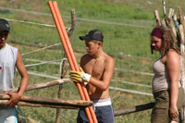
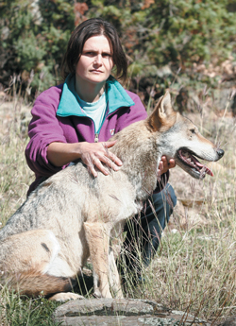
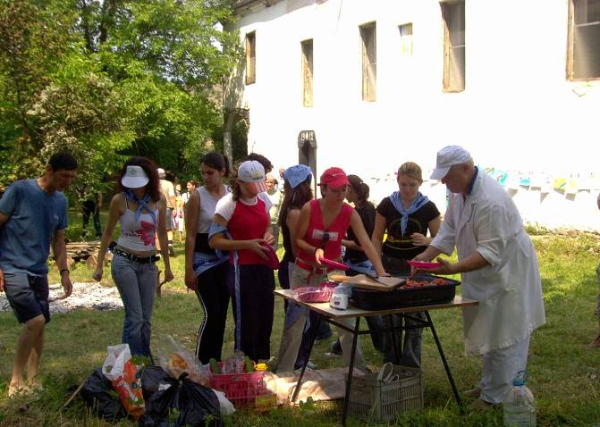
The Kresna Municipality Village of Vlahi is situated close to Pirin National Park
Young people practice eco-tourism
Eco-center Vlahi

Slide 22
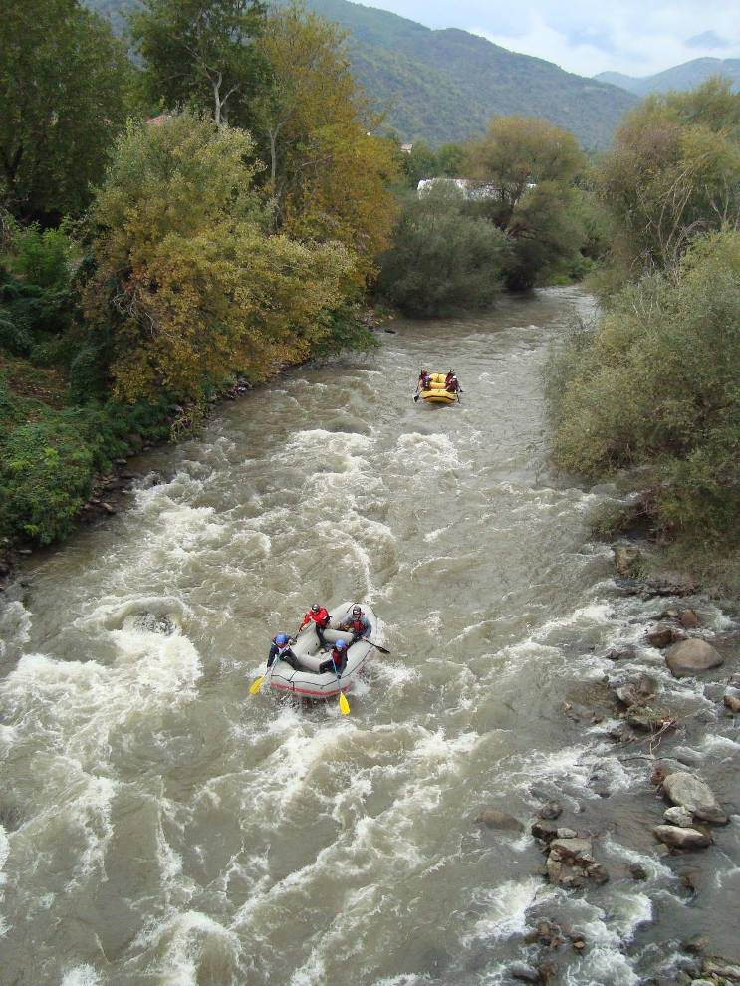
Our region provides excellent conditions for the development of extreme water sports like rafting and kanookayak due to the rapid waters of the Struma river, passing through Kresna.
Extreme water sports

Slide 23




Rafting lessons

Slide 24

“St. Paisiy Hilendarski”
Secondary School
Our school

Slide 25

"St. Paisiy Hilendarski" Secondary school at the Town of Kresna has 4 storey massive building, public municipal property, equipped with central heating, telephone and Internet network.
Our school

Slide 26

Bilology cabinet
Our school

Slide 27

Primary education cabinet
Our school

Slide 28

Conference room
Our school

Slide 29


Opening school year
Our school

Slide 30

Our school

Slide 31

Our school

Slide 32

We are very happy to welcome you to our countryside!
Enjoy your stay in Bulgaria!
This is Bulgaria

Slide 33

Thank you for your attention!
This is Bulgaria

