Slide 1
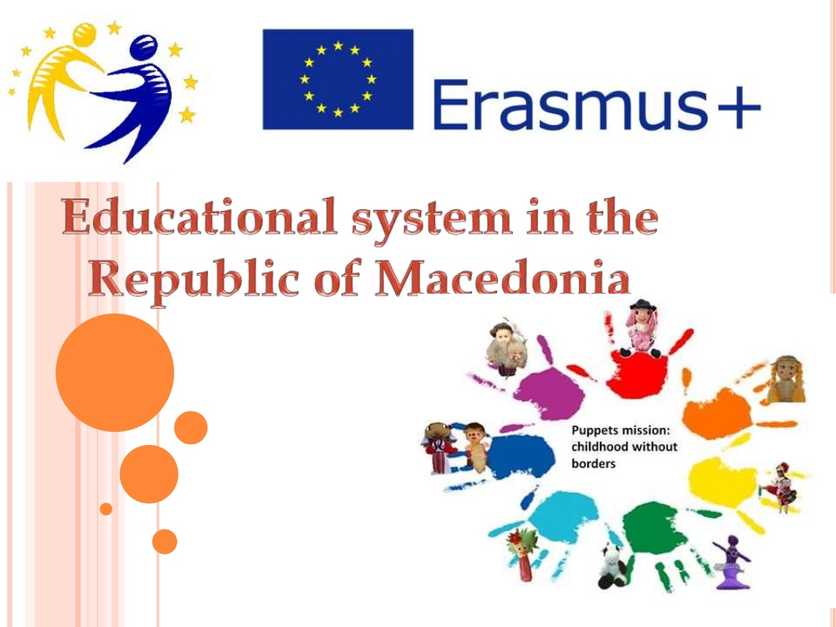
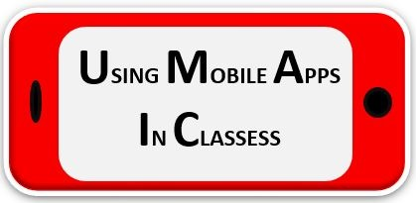
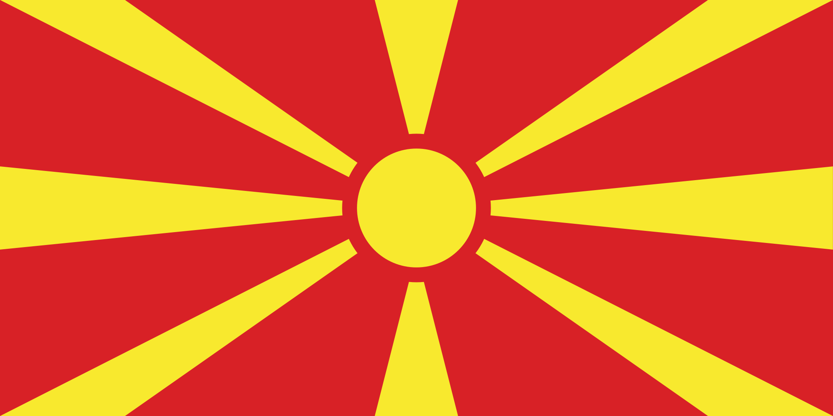

Slide 2
The educational system in Macedonia provides schooling for about 275,000 pupils (about 13.5% of total population), out of which 192,000 in primary education and 83,000 in secondary education. The teaching in Macedonian schools is conveyed in four languages. Apart of the Macedonian language as official language in the country, the pupils have option to select studying in Albanian, Turkish or Serbian. In some schools the students also have the option to select non-compulsory (elective) subjects for learning about the culture and language of Aromanians or Roma people.

Slide 3
Stages of the Education System
Education is compulsory between the ages of six to 19 for general secondary education, or from six to 17, 18 or 19 for vocational education and training depending on the selected VET track.
The educational system in the Republic of Macedonia consists of three sub-systems:

Slide 4
Primary education (ISCED 1 and ISCED 2): in duration of nine years, free of charge and compulsory for all children aged 6 to 15, with no regards to the gender, religion and nationality. The primary education activities are defined and regulated by the Law on the Primary Education and with the Concept for Nine-years Primary Education. The mission of this sub-system is to raise, educate and guide. In the first three grades the assessment of the pupils is descriptive, and for the rest of the grades is numeric (marks 1 to 5). Private primary education schools are not recognized in Macedonian education system. However, private primary schools exist and their pupils are mainly of foreign citizenship.

Slide 5
Secondary education (ISCED 3): general secondary education (Gymnasium) in duration of four years and vocational education (Vocational Schools) in duration of two (vocational education of two years), three (vocational education for professions) or four years (vocational technical education). The secondary education is compulsory and comprises all children in the age cohort 15 to 19 years for the general secondary education, and for the age cohort 15 to 17, 18 or 19 in the VET depending on the selected track. The activities and responsibilities of the secondary education are defined and regulated with the Law on the Secondary Education and the Law for Vocational Education and Training.

Slide 6
The secondary education is free of charge in the public secondary schools. The pupils also have the legal option to enroll into the private secondary schools which are officially recognized by the Macedonian educational system; there are 16 private secondary schools in the country. In several schools in the country there are bilingual classes in which the teaching of non-language subjects is performed in foreign language (French or English);

Slide 7
Higher education (ISCED 5, 6 and 7): implements under-graduate, master and doctoral studies in the higher educational institutions and institutes which are autonomous and independent. There are seven state universities and 14 private universities in the Republic of Macedonia. The activities are defined and regulated by the Law on the Higher Education. In accordance to the national policy for provision of equal access to the higher education, social cohesion and lifelong learning, the state introduced the Project 35/45, which promotes enrollment of the students from the age cohort 35 to 45 years.

Slide 8
The educational system comprises also the children with special needs and who are enrolled in the schools for special education or within the regular teaching process depending on the preferences of the students and their parents. There is separate curriculum for these schools.

Slide 9
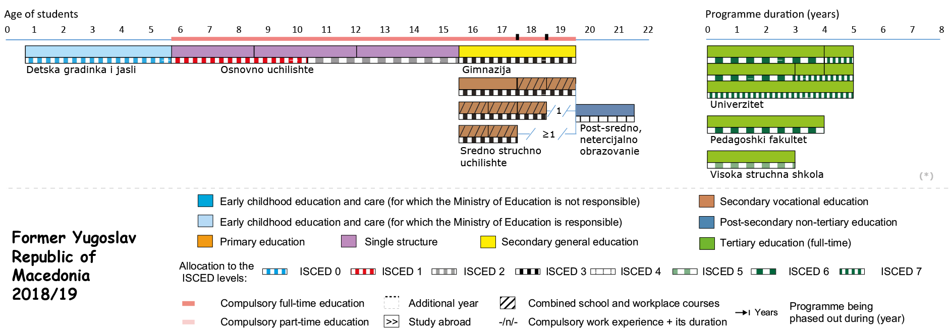
Structure of the National Education System

