Slide 1
TURKISH
NATIONAL
EDUCATION SYSTEM

Slide 2
TURKISH NATIONAL EDUCATION SYSTEM
(CONSTITUTION)
MINISTRY OF NATIONAL EDUCATION
DIRECTORSHIP OF PROVINCE
DIRECTORSHIP OF COUNTRY
SCHOOLS
Pre-School
Special Education For Disabled
Primary School
Common Education
ch
Secondary-Primary School
High School
Higher Education (University)

Slide 3
Pre-School Institutions
They are optional private and state schools
They are kindergartens (0-2 ages)
Nursery Schools (3-5 ages)
Preparation Nursery Schools(6 Ages)

Slide 4
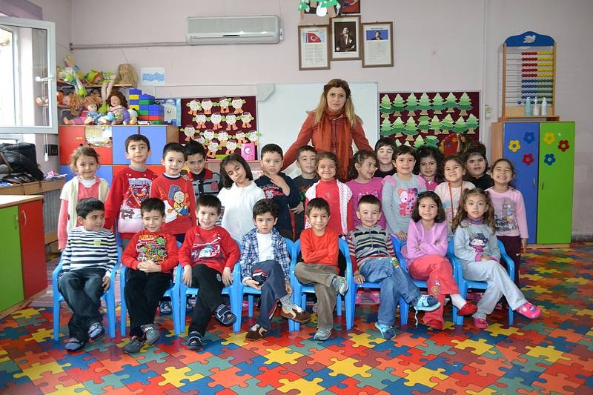

Slide 5
Primary Schools
They are compulsory Private and State Schools. Students are from 66 months to ten years old.
They just give the basic education.
These institutions are;
Free boarding primary schools
Ordinary day schools
Mobile educating(transporting students) schools

Slide 6
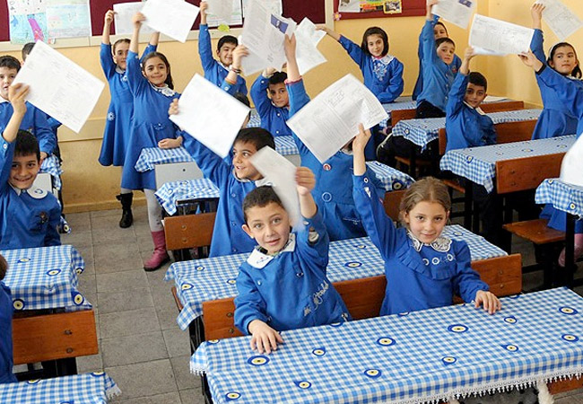

Slide 7
Secondary Primary Schools (10-14 Years)
Primary Education Secondary Schools are;
İmam(Religious Leader) Secondary Schools
Ordinary Secondary Schools
They are compulsory, free boarding and day schools. Mobile education is also possible.

Slide 8
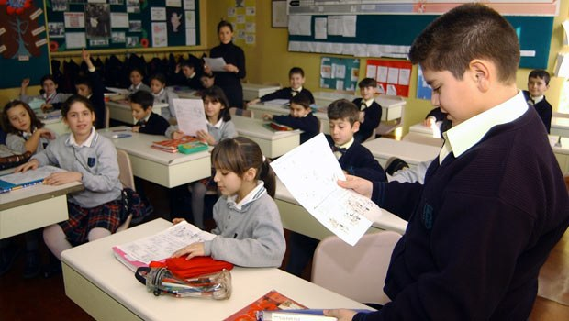

Slide 9
Secondary Education
A. Academic High Schools
B. Vocational High Schools
C. Skill Schools

Slide 10
A. Academic High Schools
Science High Schools
Anatolian High Schools
Social Sciences High Schools

Slide 11
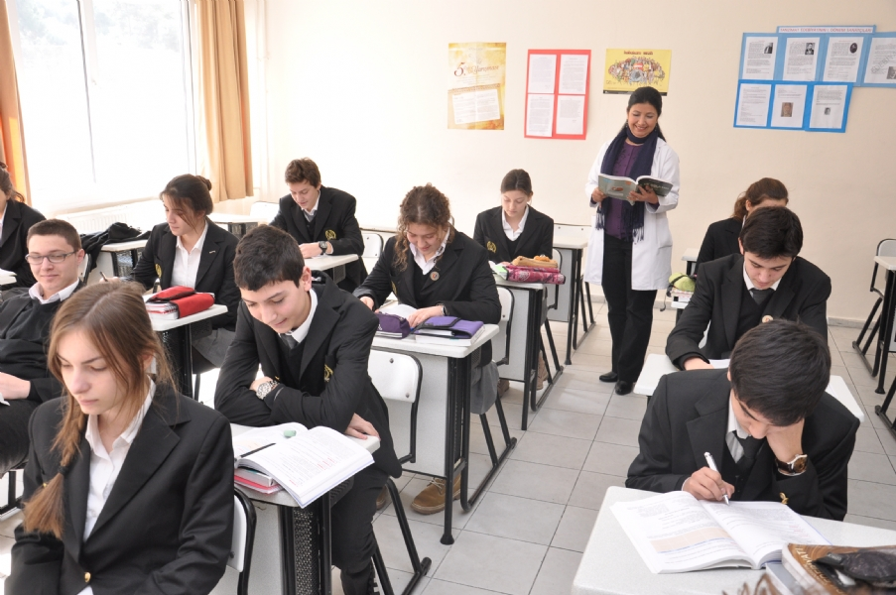

Slide 12
B. Vocational High Schools
Technical High Schools
Commerce High Schools
Health and Medicine High Schools
Land Registry and Cadastry High Schools
Aerology High Schools
Military Schools
Police Vocational High Schools,

Slide 13
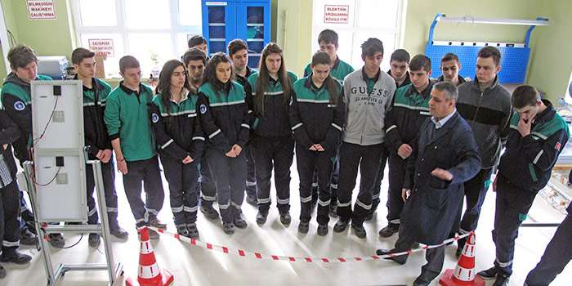

Slide 14
C. Skill Schools
Sports High Schools and Fine Arts High Schools
The education in these schools are for four years.
15-19 years old students
Boarding, day and mobile educating schools
Registration to schools is done according to the result of the exams assessing the students skill

Slide 15
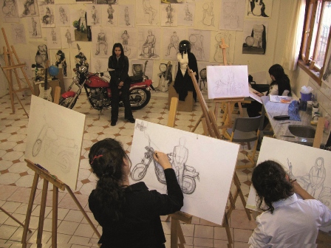

Slide 16
Higher Education (University)
YÖK(Higher Education corporation)
Faculty( Generally four years except for Medicine and Enginering Faculty)
Upper Secondary Education(two years)
Vocational Upper Secondary Education(two years)
Master’s Degree
Students are accepted by central University Entrance Exams
Vocational High School students can go on Upper Secondary Education without having an axam.

Slide 17
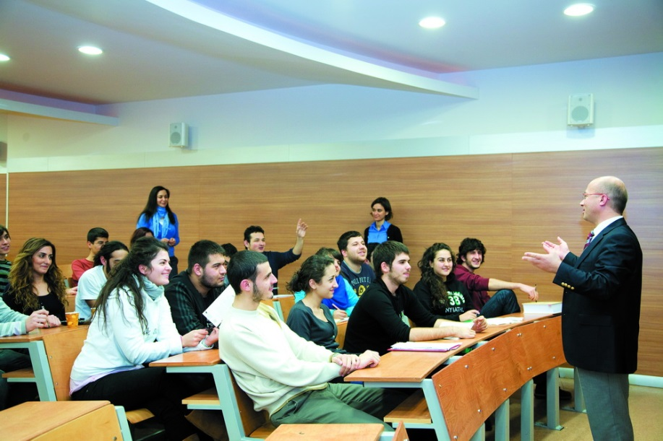

Slide 18
Other Education Centers
Common Public Education
Special(for Disabled) Education Centers

Slide 19
Common Public Education
Public Education Institutions( A very large scope of education depending on the demand of students)
Vocational Education Instutitions
In Service Traininig centers
Private Courses
Evenining Schools
Distant Training(Primary, Secondary, High School)
Advanced Technical School for girls
Special(for Disabled) Education Centers

Slide 20
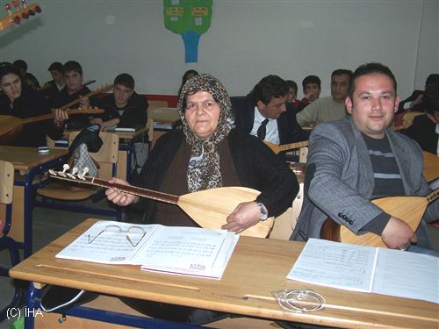

Slide 21
Special(for Disabled) Education Centers
These schools are for deaf, blind and Mentally disadvanteged children. They are private and state schools. Students are registered according to the level of their handicap.
Private schools are paid by the government.

Slide 22
