Slide 1
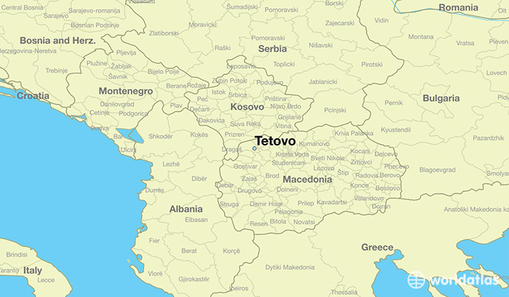
Tetovo, Macedonia

Slide 2
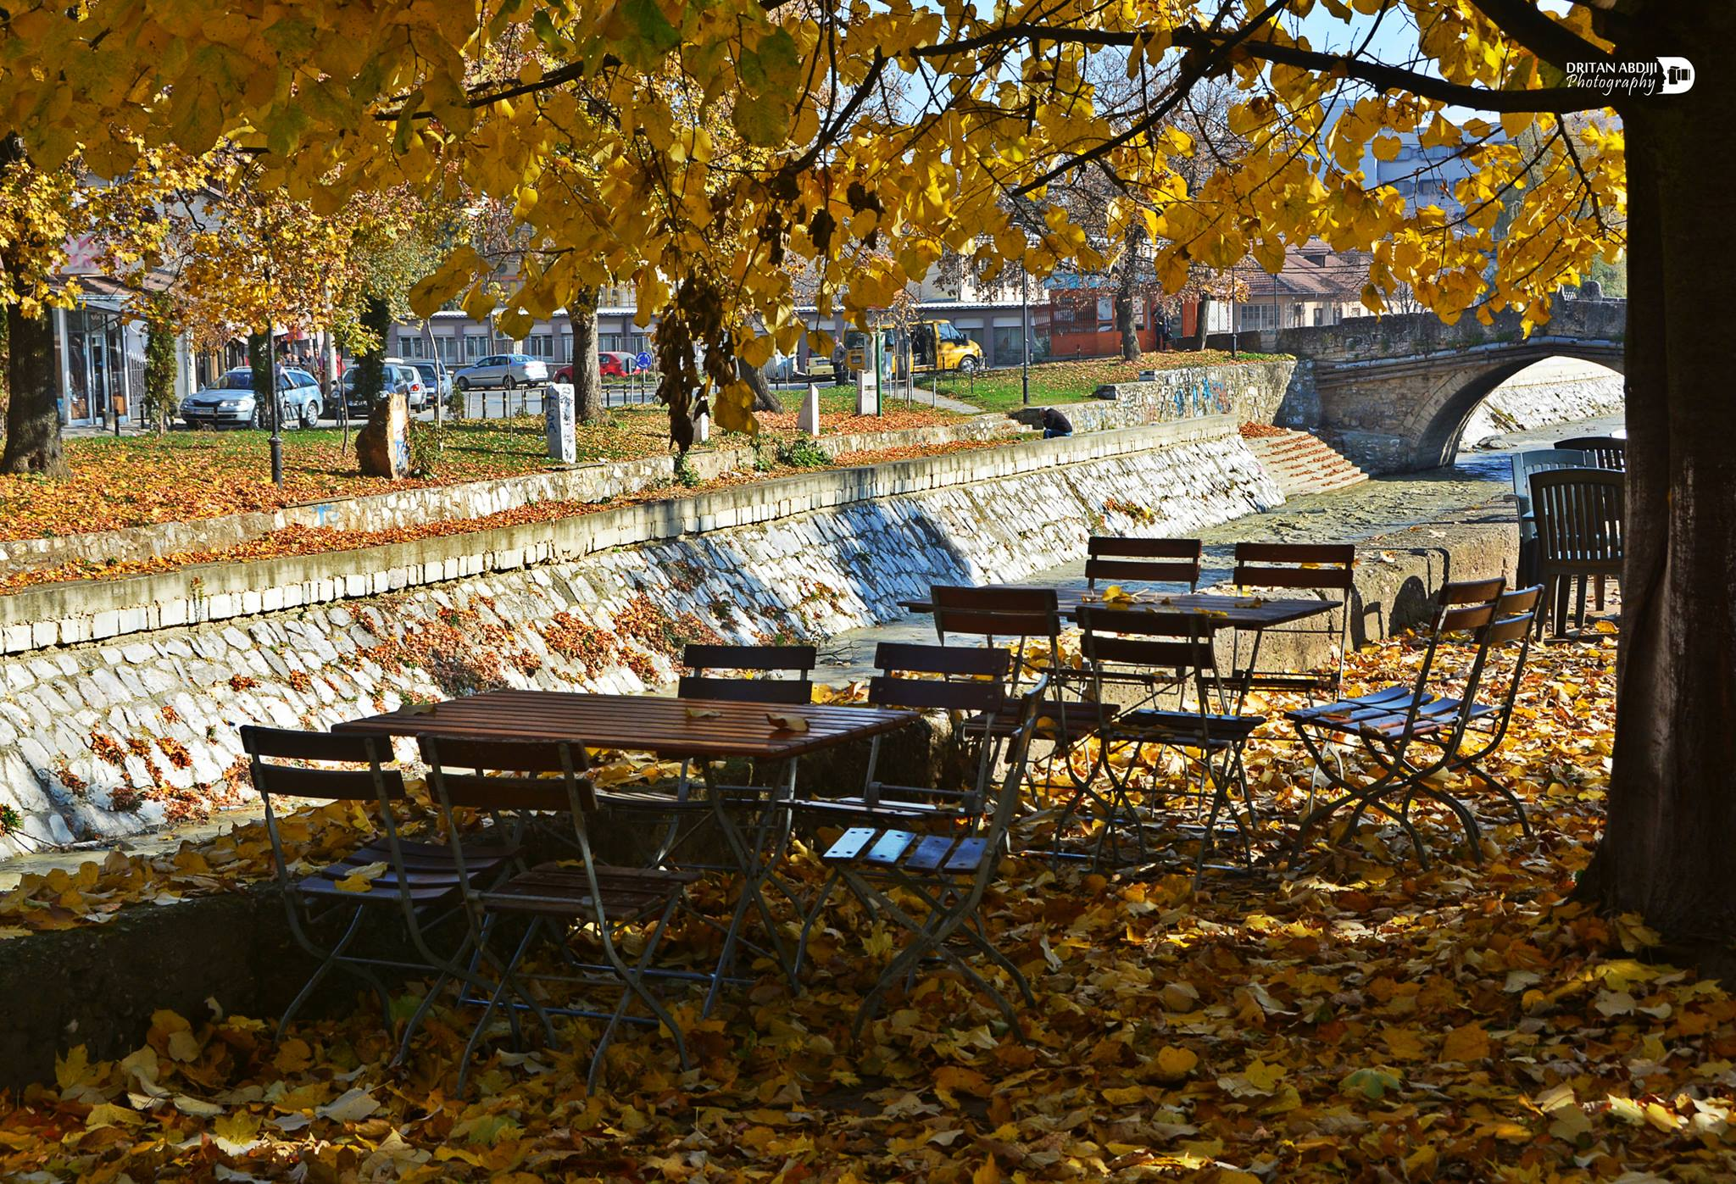

Slide 3
Basic information about the city of Tetovo
Tetovo is a city located in northwestern Macedonia, on the slopes of Shara, in the lower Polog Valley. Tetovo is the seat of the same-named municipality , which covers an area of 261.89 km2, together with the newly created municipalities that derived from it and which even nowadays gravitate towards it.

Slide 4
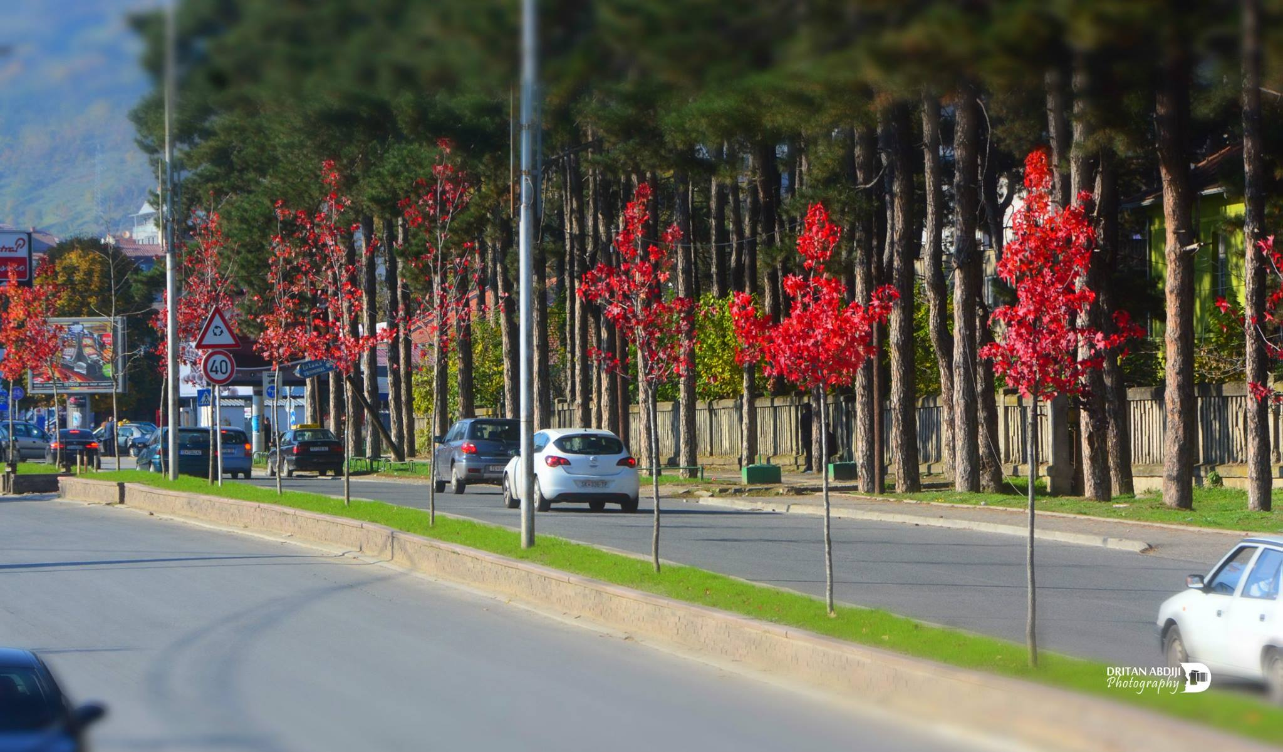

Slide 5
Legends about the city of Tetovo
In the immediate vicinity of the city, between the two hills, there was a large snake from which everyone was afraid. some Teto armed with a bow and arrow went towards the endangered place. When he arrived there, the snake appeared and blocked the road. Teto was not afraid. When the reptile approached him, he waved his sharp and pointed sword and slashed it. In that manner, the people were released from the dangerous beast. The fear came out of them, and the passage between the two hills was free and easily passable.
The place where the snake was killed with a sword and a shield, (kalkan), was called Kalkandeli, and the city, (in Turkish), - Kalkandelen. In memory of the hero Teto, on the other hand, the local population called the settlement with the name Tetovo.

Slide 6
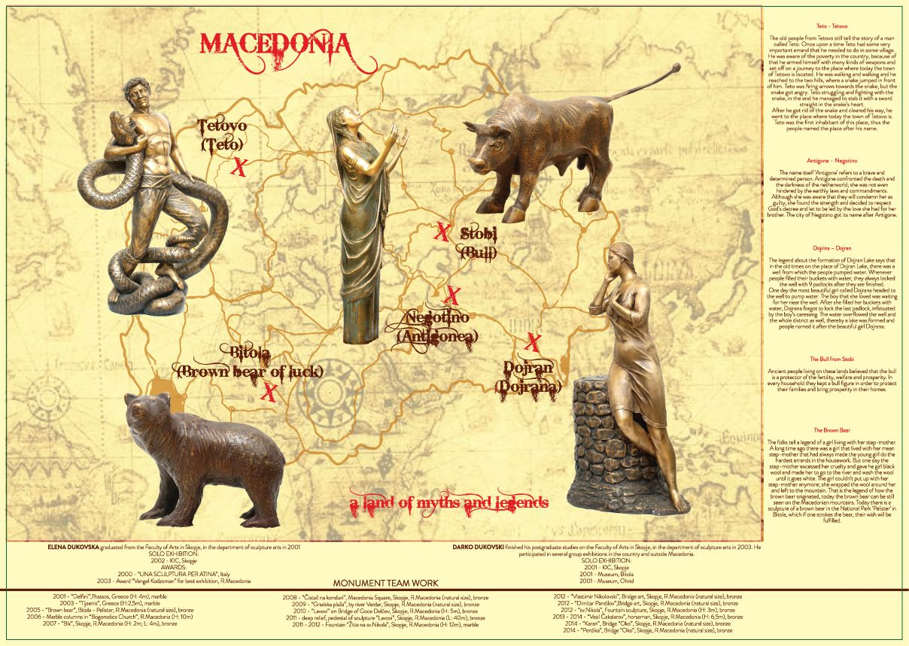

Slide 7
History about the name of Tetovo
According to the folk etymology, Tetovo originates from the word tendon. In connection with this interpretation, even then the Turkish name of the settlement - Kalkandelen appeared. The famous Turkish traveler Hadzi Kalfa, who visited Tetovo around the middle of the 17th century, mentioned the city with the names Kalkandelen and Tetova. In Albanian, the name of the city is Tetovë, that is Tetova.

Slide 8
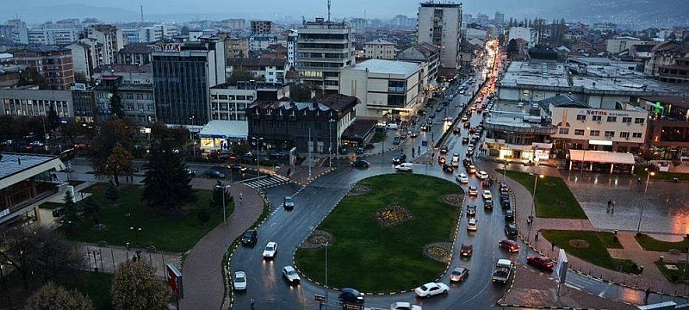

Slide 9
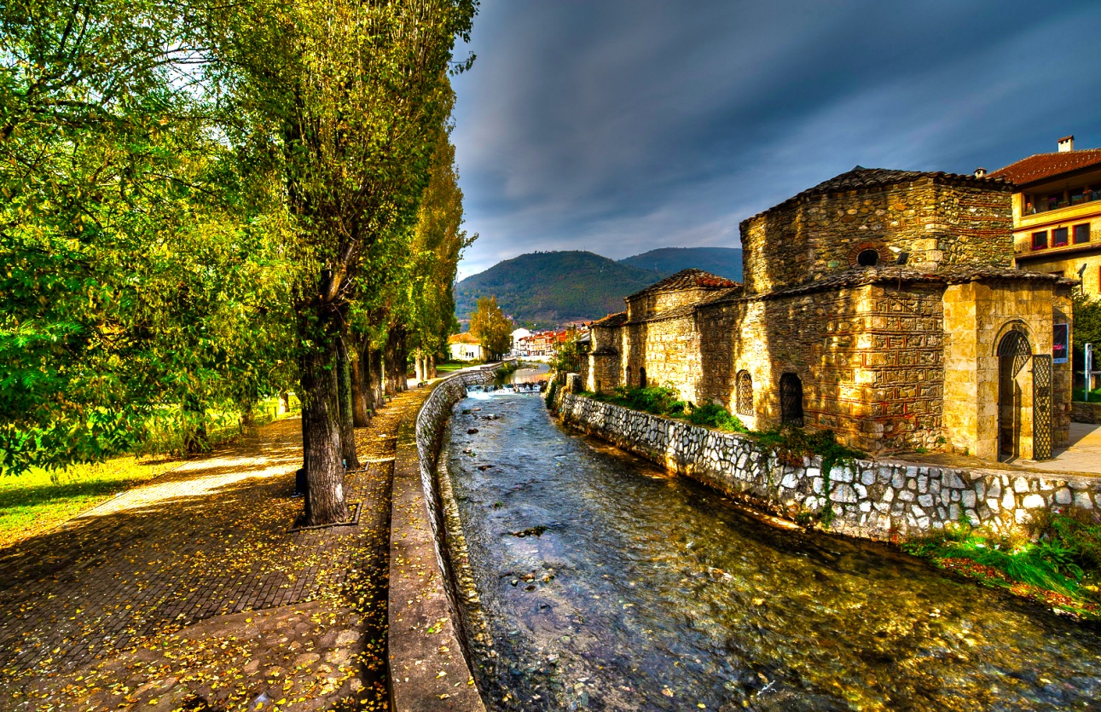
Early development of the city
Most of Tetovo stretches in the plain area, and only a smaller part lies on the slopes of Baltepe, a hill 806 metres high. The absolute altitude of the city ranges between 450 and 500 metres. Lately, urban planners are making efforts for the city to extend to the mountainous area that is mildly elevated and favourable for a city construction district.

Slide 10
Climate conditions
A city with a medium continental climate with warm and relatively humid summers, cold and snowy winter, spring and autumn with frequent precipitation. Natural conditions such as climate, relief, geological composition of the country enabled many water sources to appear in the Tetovo area.
The city was divided into two parts in the past, Upper and Lower Charsia. In the upper part, mostly Muslims lived, and in the lower Christians. Tetovo as a multicultural environment is characterized mainly by two major religions. These are Islam and Christianity, i.e. Orthodoxy.

Slide 11
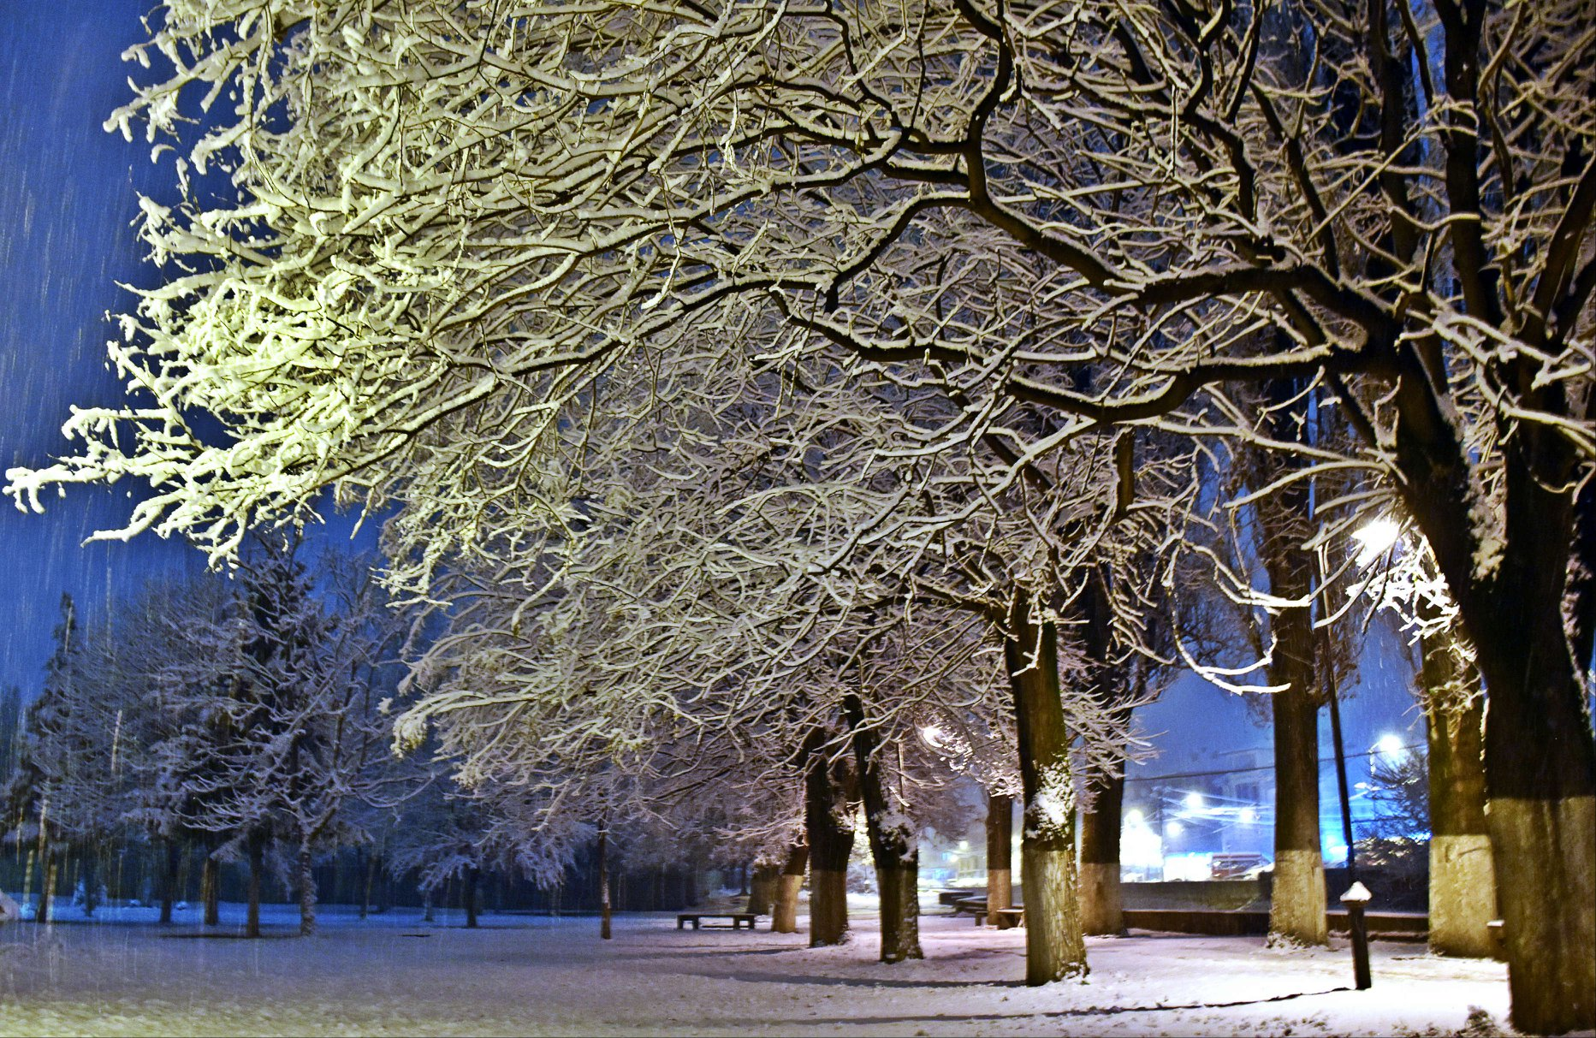

Slide 12
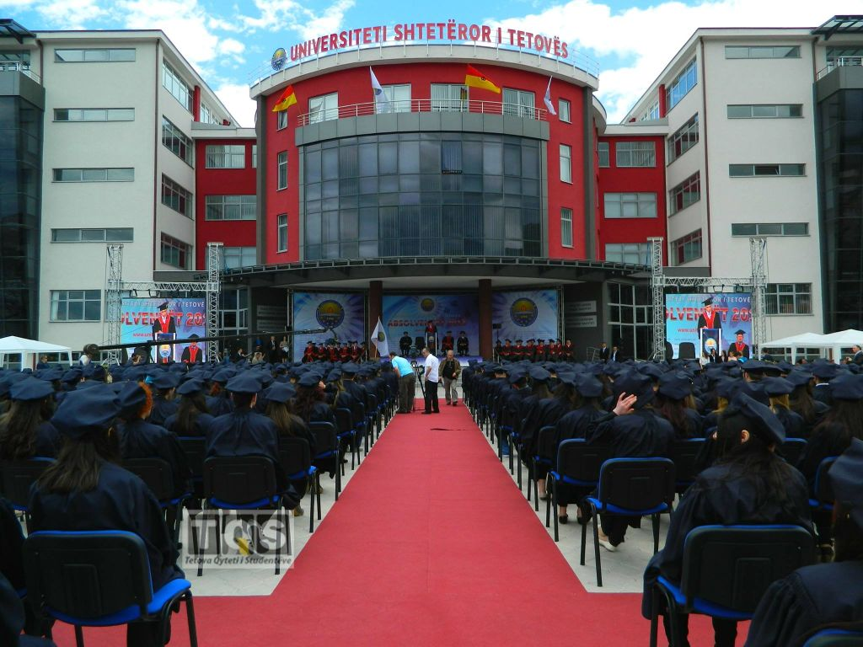
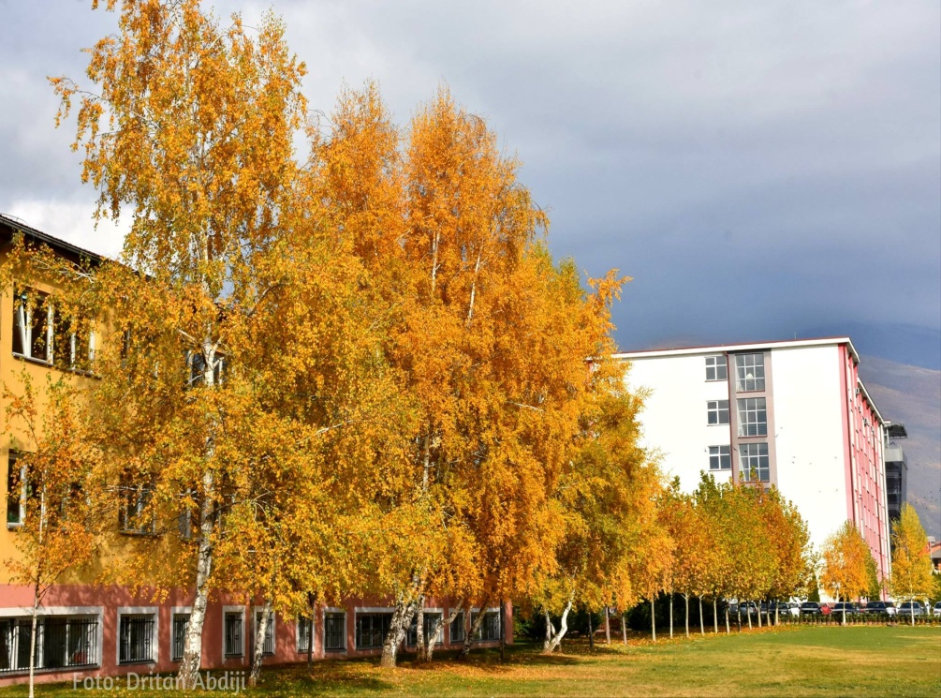
Tetovo also has two universities: the South East European University, which is the third largest university in Macedonia and the State University of Tetovo.
Universities of Tetovo

Slide 13
The most valuable objects in the city are:
The painted mosque (Xhamia e larme);
Hamam - near the Shkumbin River in Tetovo;
The Castle of Baltepes (Kalaja e Baltepes);
Baba Harabat's Tekke (Arabati Baba Teqe);
Hills of the sun (Kodra e Diellit).

Slide 14
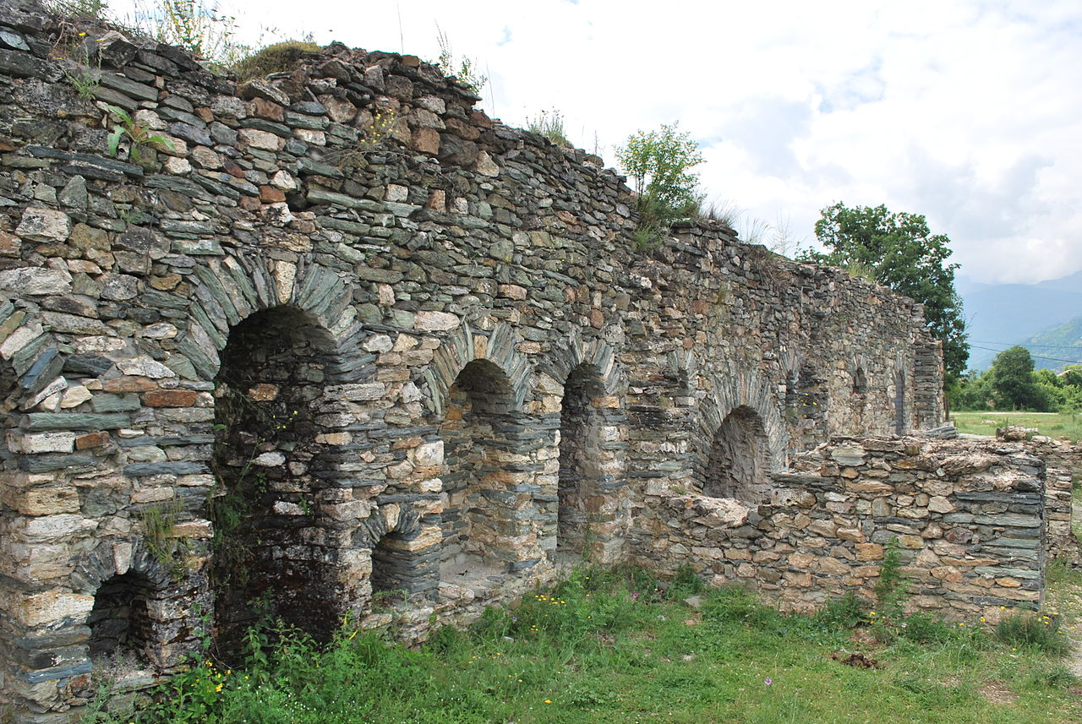
Tetovo Kale (19th century)
Tetovo Kale is a more recent fortress, built around 1820. It is located in the immediate vicinity of Tetovo, at the foot of Shar Planina. It has an altitude of about 800 metres above sea level, and in relation to the city rises about 300 metres. The construction was initiated by Redzip Pasha and it was continued by his son, Abdurahman Pasha. The fortress was built of calcareous and carved stone.

Slide 15
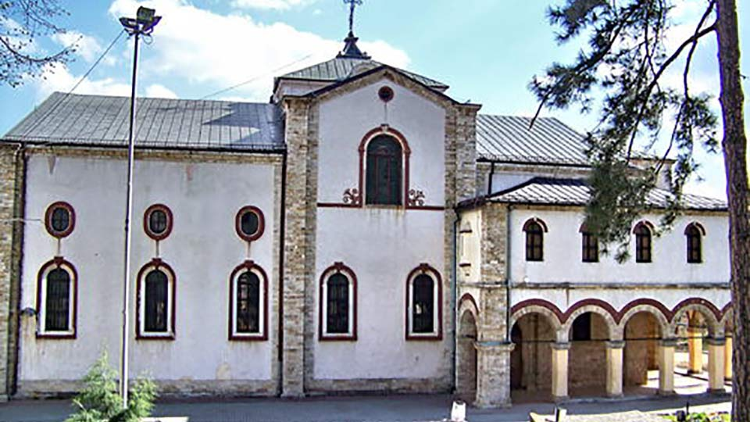
Church Ss. Cyril and Methodius
This church is located in the old part of Tetovo. It was built in the period from 1903 to 1918, and it was consecrated in 1925. The frescoes were made by Danilo Nestorovski in 1924. The church is a three-nave basilica with a central dome

Slide 16
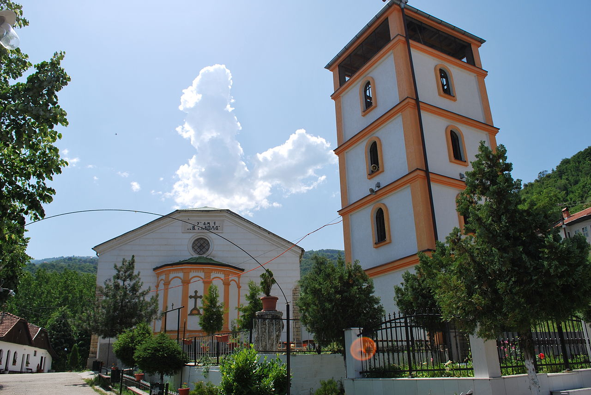

Slide 17
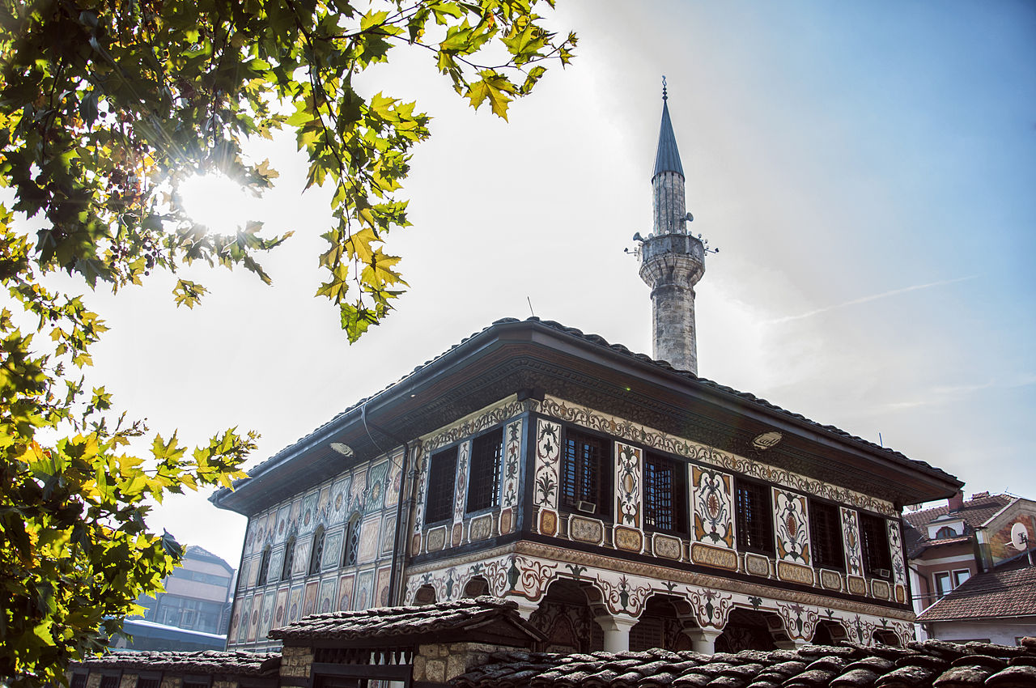
Painted mosque – Sharena Dzamija (15th century)
It is a monument of culture dating from the 15th century, which was upgraded and expanded in the 19th century by Abdurahman Pasha, a Turkish feudal master of the Tetovo pashalak. It is located in the old part of Tetovo, beside the river Pena. It is a one-room square building with an architectural combination of Baroque and Neoclassical Ottoman construction style. TThe numerous vividly painted ornaments, the colourfulness and the used painting techniques are a rarity and an extraordinary work of Islamic architecture.

Slide 18
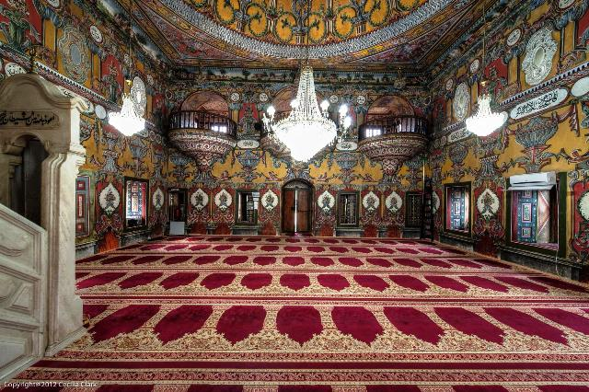

Slide 19
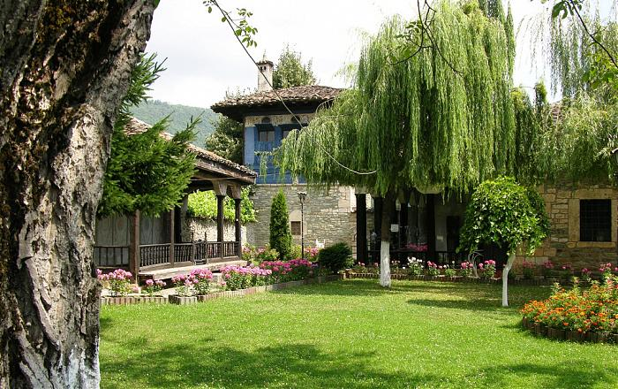
Arababati-baba tekke (XIX century)
Arabati-baba tekke was built in the 19th century by Redzep Pasha and his son Abdurahman Pasha. It is a religious building, in addition to the Sersem Ali-Baba's turbe from the 16th century, and to this day the fountain, tower, turbe, kitchen with dining room, faucet, guest accommodation, dervishane and haremlik are preserved. All of this is part of the complex, which until 1912 had an active dervish life until 1912. Nowadays, it houses the National Museum of Tetovo.

Slide 20
Hills of the sun (Popova Shapka)
Shar Mountain is located near Tetovo, with a length of 80 km and an area of 1,600 m2. Popova Shapka, with an altitude of 1,780 metreers, is a tourist site of Shar Mountain and is one of the most famous winter and recreation centres in the Republic of Macedonia. It offers extraordinarily convenient ski and sledding facilities, equipped with several cable cars and ski lifts. Popova Shapka has many weekend houses and modern tourist-catering facilities.

Slide 21
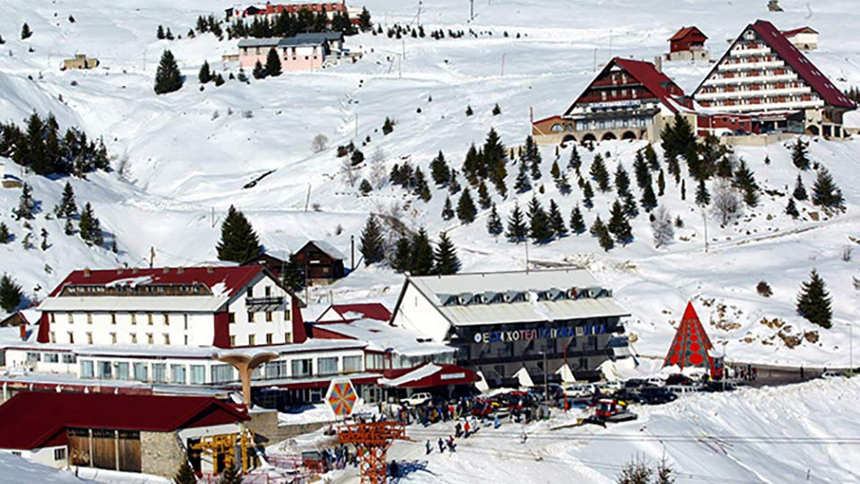

Slide 22
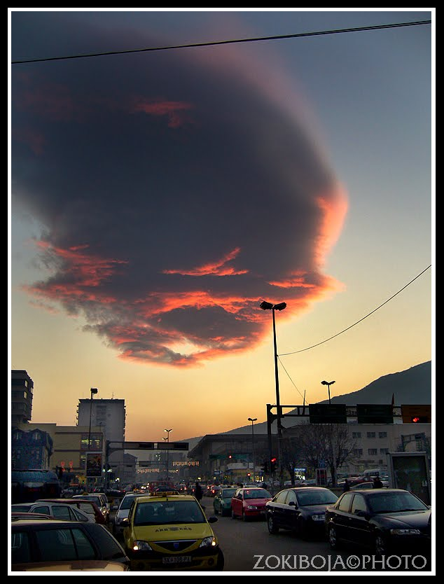

Slide 23
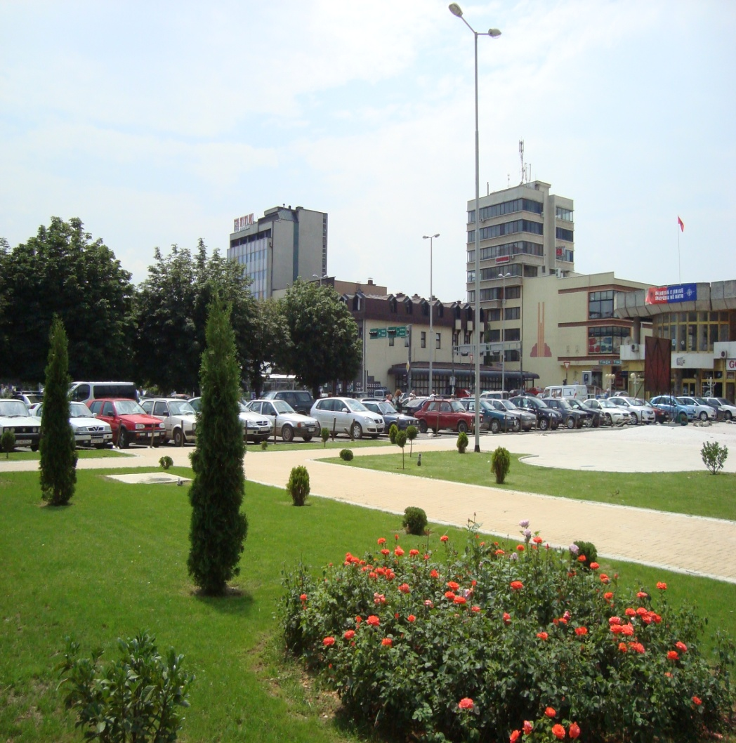
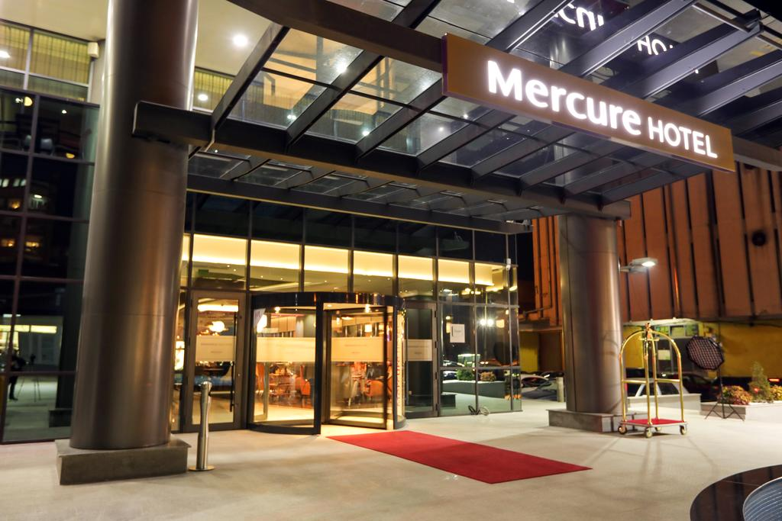
The center of Tetovo

