Slide 1
WiFi :
Zdravka
Password:
Zdr4free
(PC – name and password : host )

Slide 2
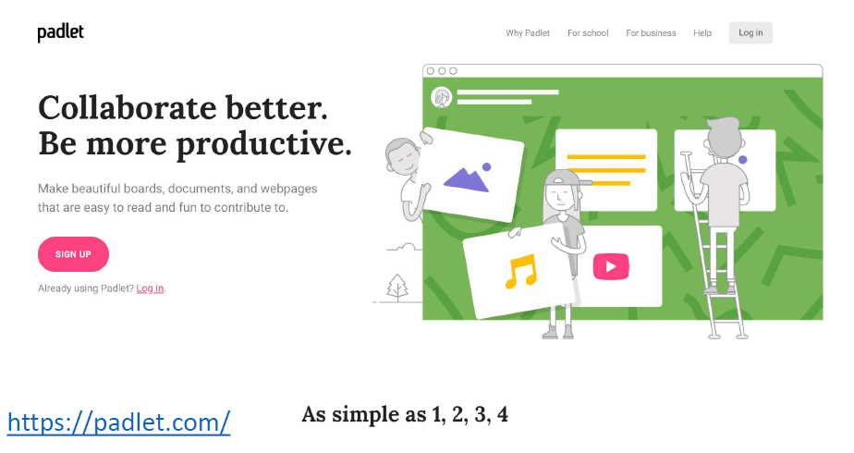
https://padlet.com

Slide 3
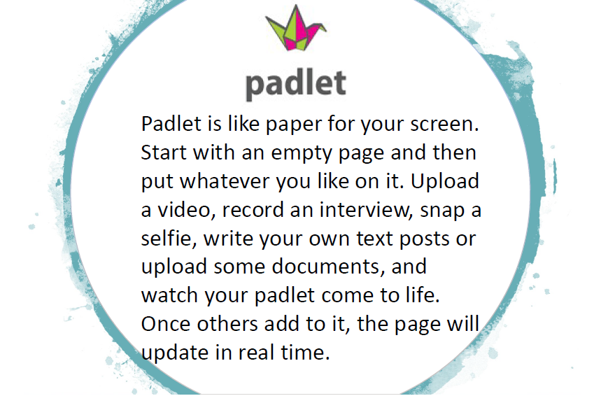

Slide 4
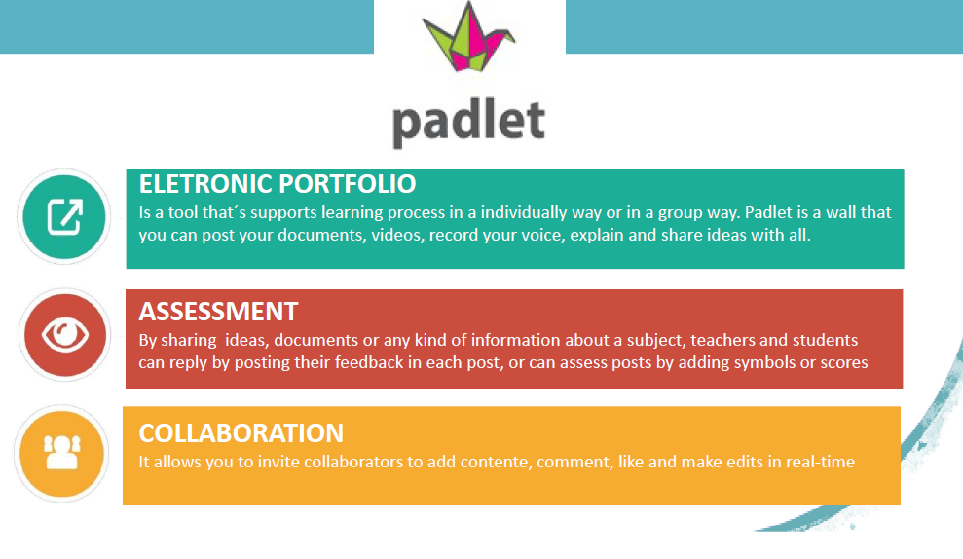

Slide 5
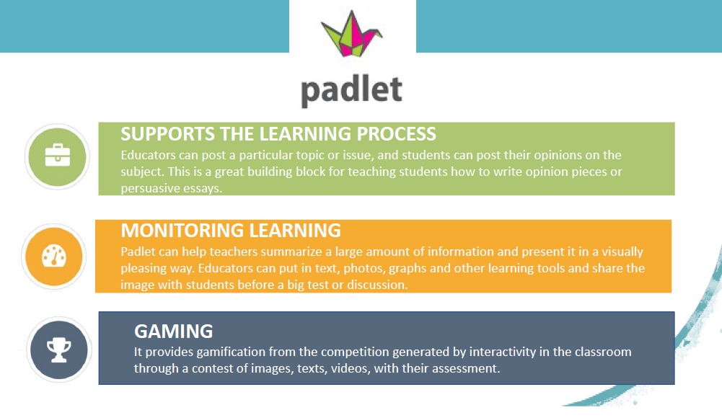

Slide 6
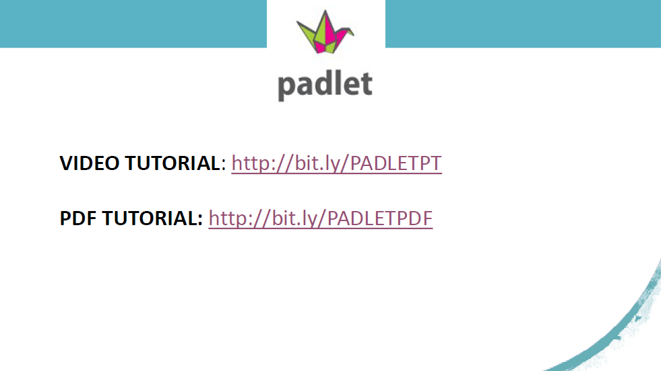
http://bit.ly/PADLETPT
http://bit.ly/PADLETPDF
www.padlet.com/mertl/mertlevent

Slide 7
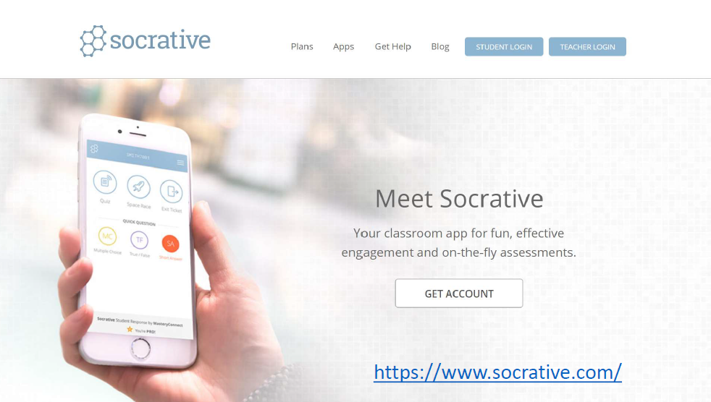
https://www.socrative.com

Slide 8
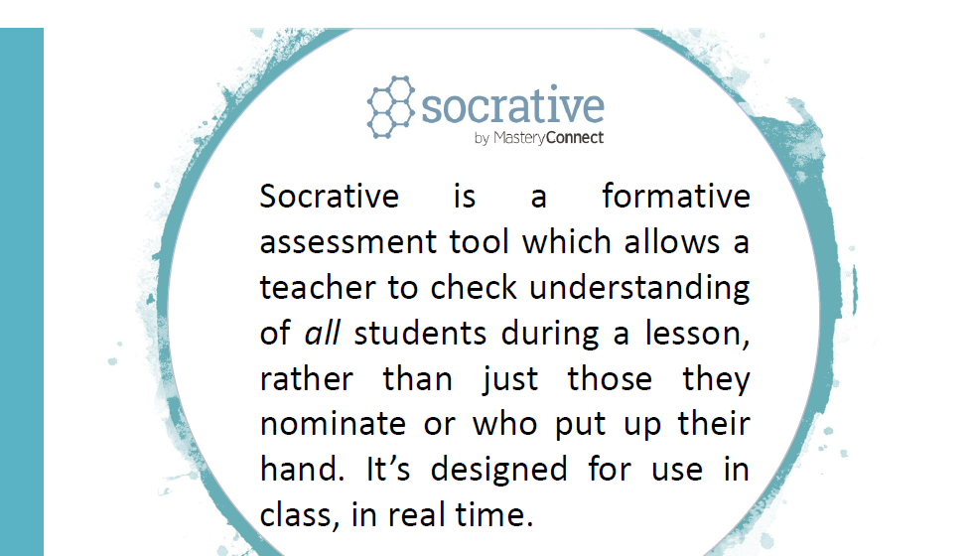

Slide 9
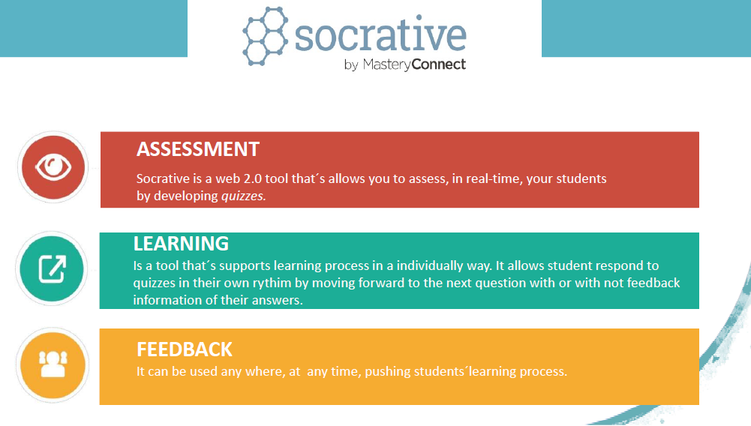

Slide 10
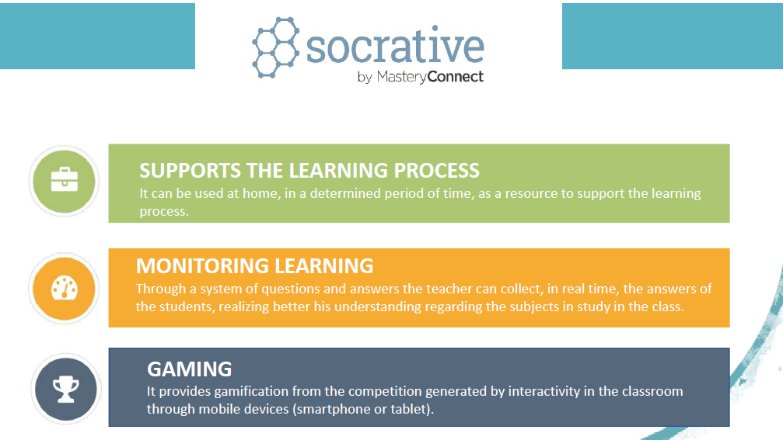

Slide 11
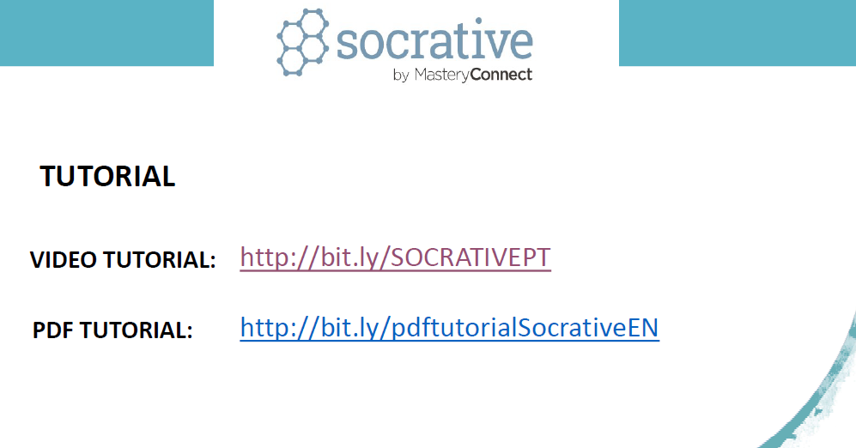
http://bit.ly/socrativept
http://bit.ly/pdftutorialSocrativeEN

Slide 12
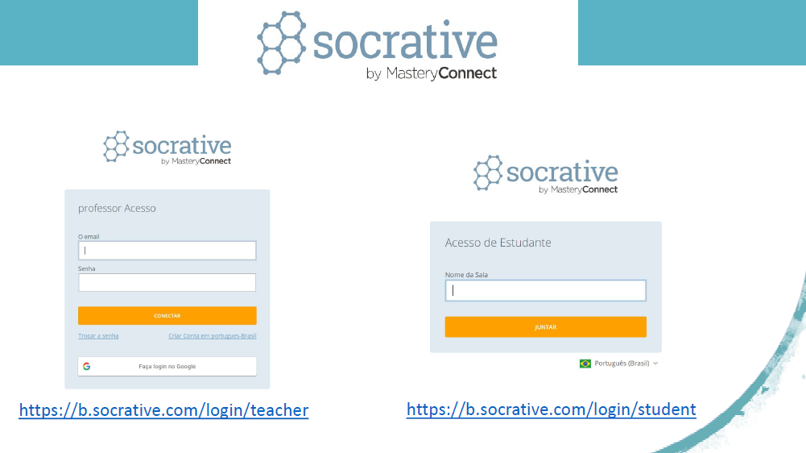
https://b.socrative.com/login/student
https://b.socrative.com/login/teacher
Room: MERTL8631

