Slide 1







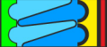
Using Mobile Apps in Classes
2020/2021
Escola Secundária de Barcelinhos

Slide 2

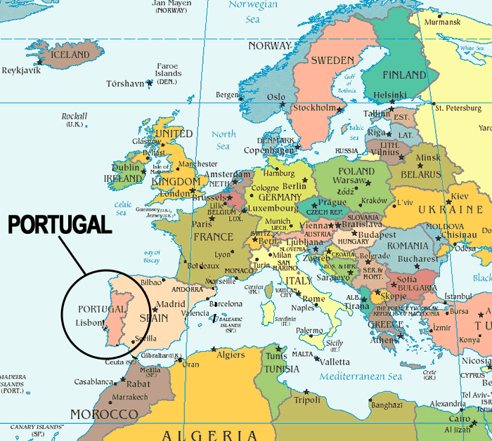
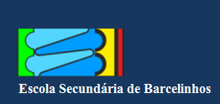
Portugal in Europe
Portugal is a small country in the Southwestern part of Europe
It is bordered on the north and east by Spain and the south and west by the Atlantic Ocean
The national territory includes
a mainland and two autonomous
regions: Azores
and Madeira

Slide 3
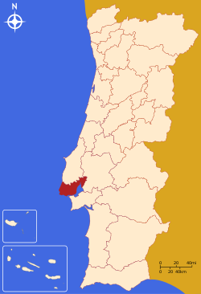

Portugal in Europe
The capital of Portugal is Lisbon
We are approximately 10 million
people
Our official language is
Portuguese which is the
sixth most spoken language
in the world
Lisbon

Slide 4
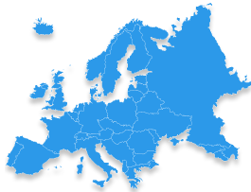

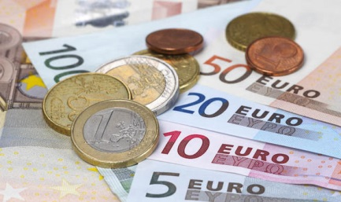
Portugal in Europe
Portugal is a member of the
European Union since 1986
and a member of the Eurozone since
2002, so the Portuguese national
currency is the Euro
We joined the United Nations in
1955

Slide 5
Economic Statistics of Portugal
Portugal’s Gross Domestic Product (GDP) per capita has increased during the years as a consequence of the country’s level of development
However, compared to the European Union our GDP per capita is lower
EU28
2017
29,950.1
Million - Euro
Portugal
2017
s23,022.9
Million - Euro
EU28
1995
15,252.1
Million - Euro
Portugal
1995
12,129.8
Million - Euro

Slide 6





Economic Statistics of Portugal
In 2017
Unemployment rate: 8,9%
Unemployment rate <25: 23,9%
Education rate: 77,6%
Literacy rate: 95.7%

Slide 7


Higher education in Portugal
In Portugal, there are 32 public higher education institutions and 122 private ones. Overall, they offer an high quality education and are a privileged space for teaching, research, innovation, sports and culture
Due to all of these aspects, the number of foreign high education students have increased in Portugal to the point that it is, nowadays, one of the most popular international destinations

Slide 8

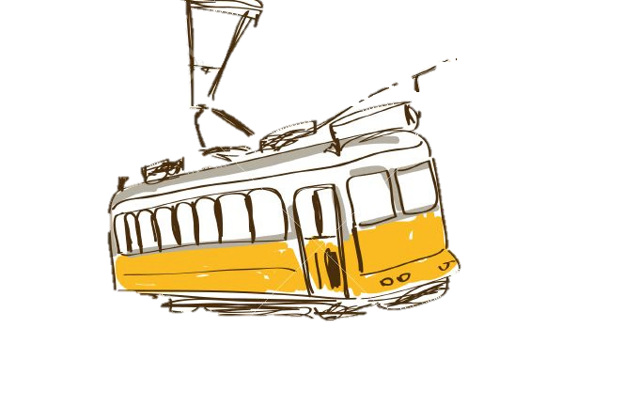
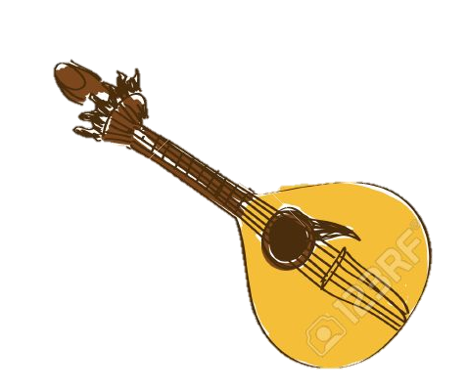




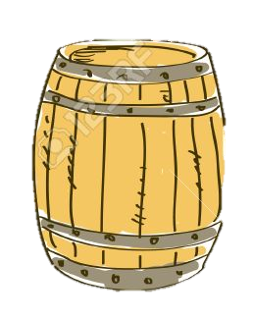
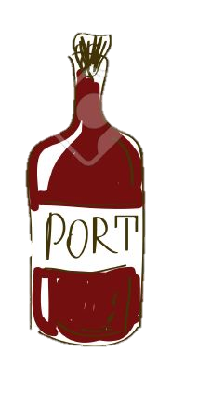

CULTURE

Slide 9
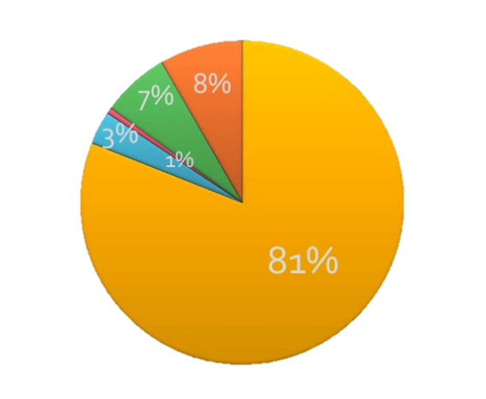
Religion in Portugal
(Census 2011)
Catholicism
Undeclared
No religion
Other Christianity
Others

Slide 10
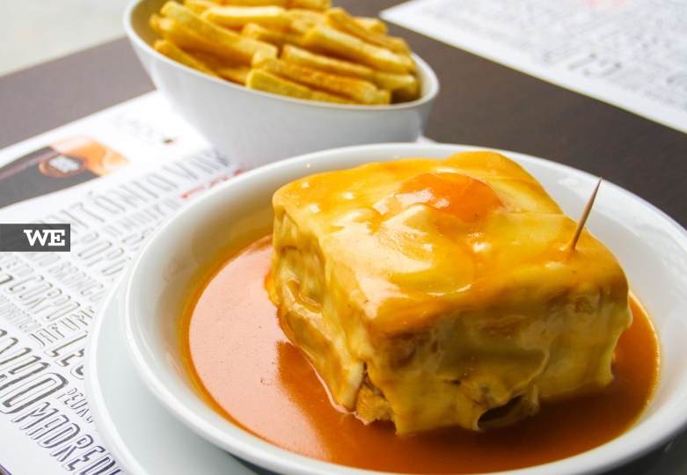
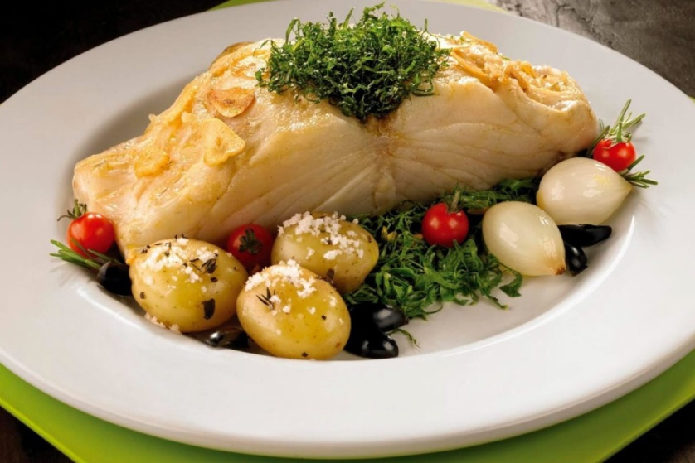
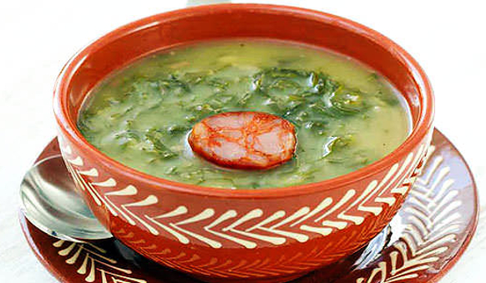
Gastronomy
Characterized by being rich, filling and full-flavored
It is closely related to Mediterranean cuisine
Francesinha
Bacalhau (Codfish)
Caldo Verde

Slide 11
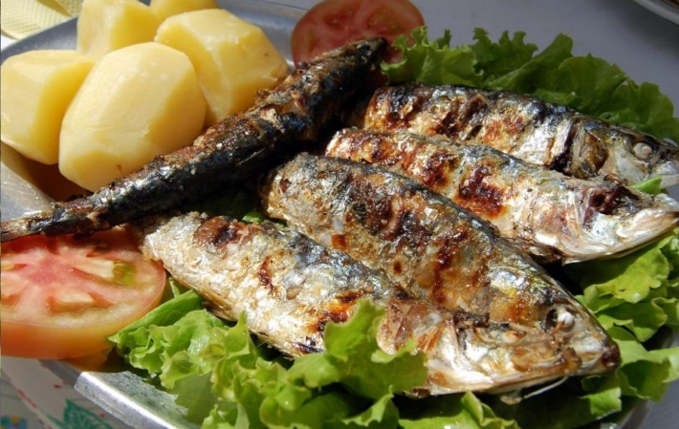
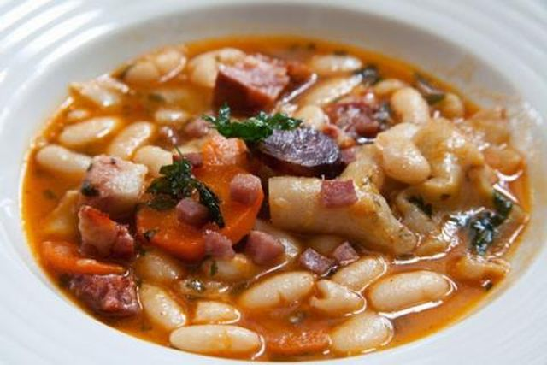
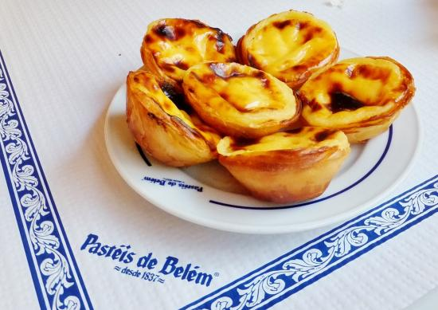
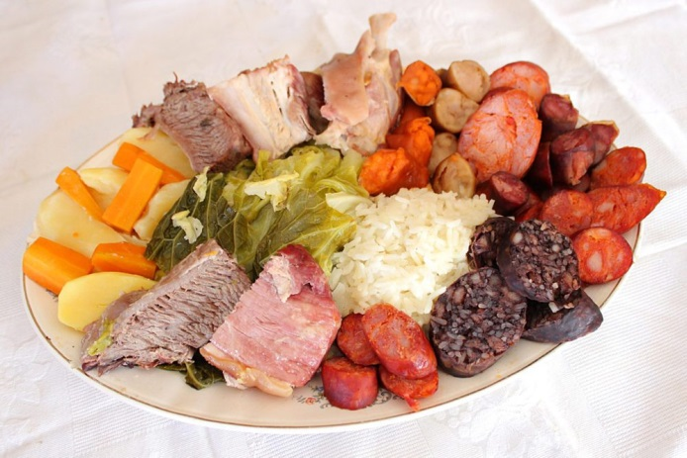
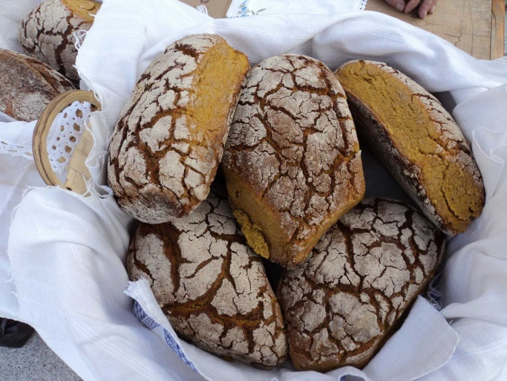
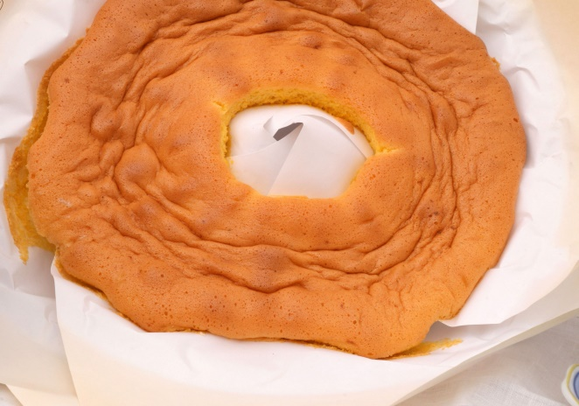
Gastronomy
Sardinhas
Tripas à Moda do Porto
Pastel de Nata
Cozido à Portuguesa
Broa de Milho
Pão de Ló

Slide 12
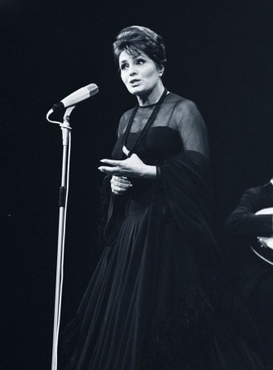
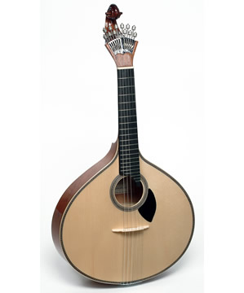
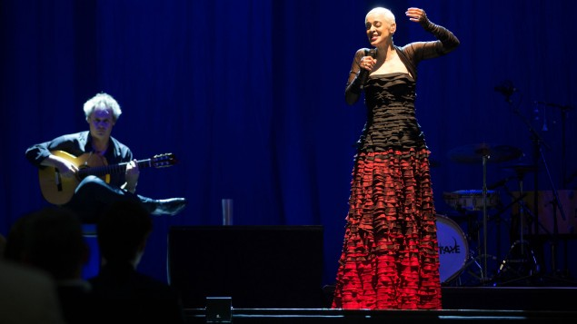
Traditional Music
Fado is a Portuguese music style. The instruments used are the classical guitar (Viola) and the Portuguese guitar.
It was considered World’s Intangible Cultural Heritage by
UNESCO.
Amália Rodrigues
Viola
Mariza

Slide 13
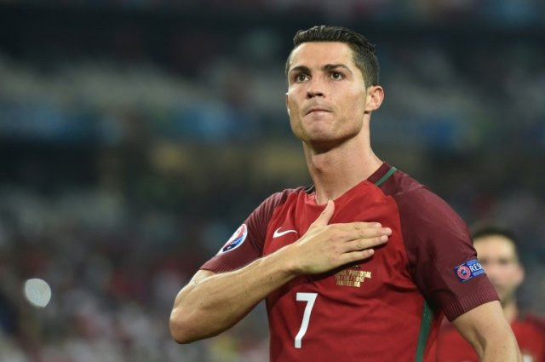
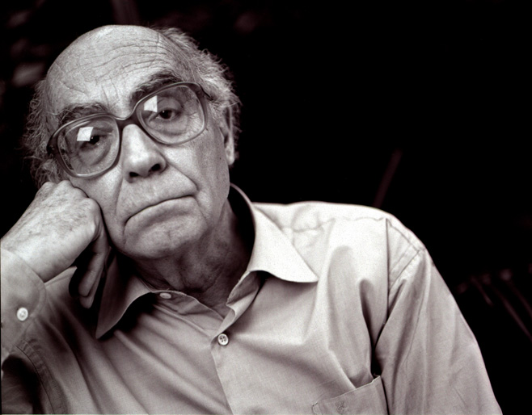
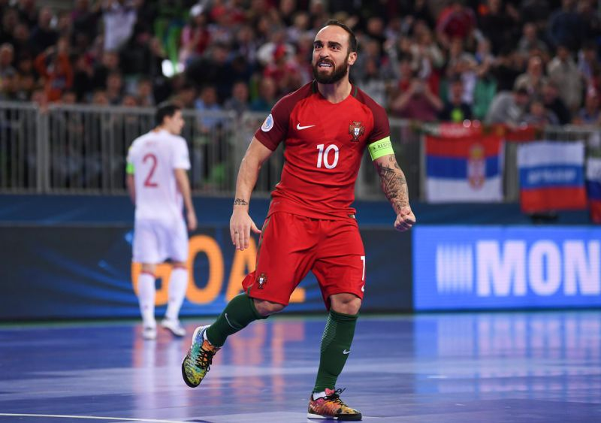
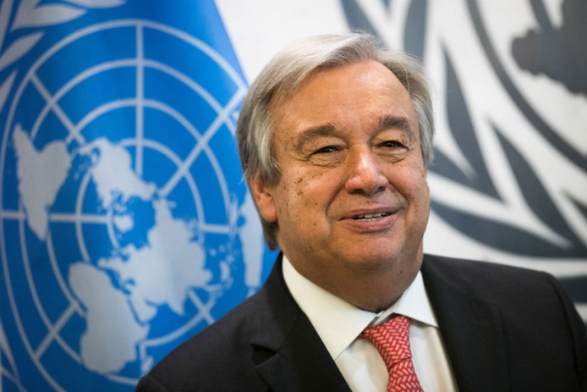
The most influential portuguese people
Cristiano Ronaldo –
Best football player in the world
José Saramago – The winner of the Noble Prize for
Literature
in 1998
António Guterres – UN
Secretary-General
Ricardinho – Best Futsal
player in the world

Slide 14
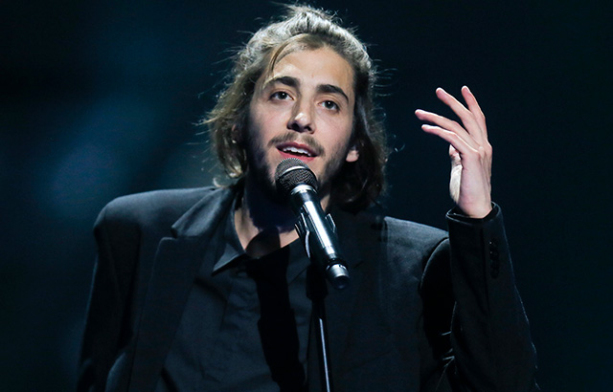
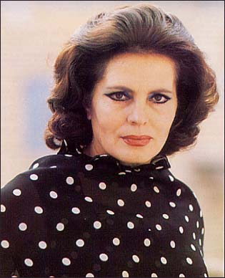
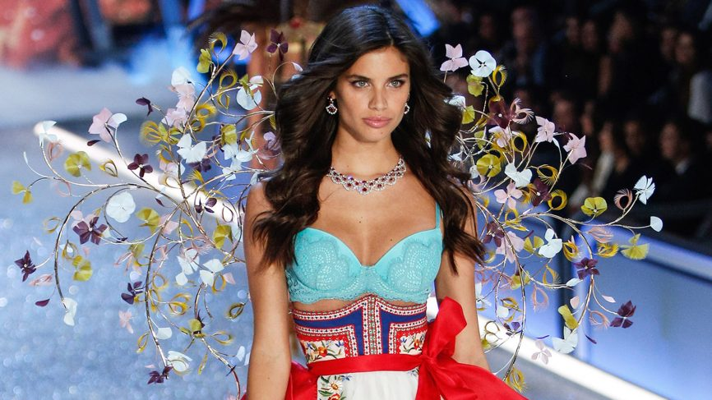
The most influential portuguese people
Salvador Sobral – Eurovision Winner in 2017
Amália Rodrigues – fado singer
Sara Sampaio – Victoria’s Secret Model

Slide 15



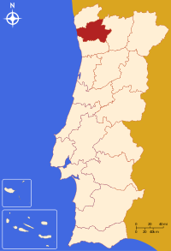
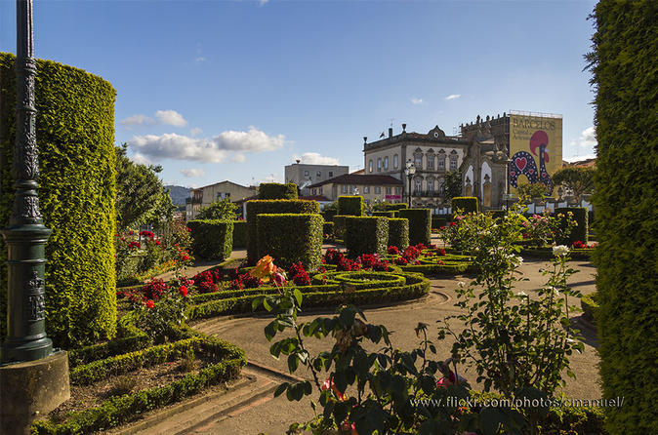

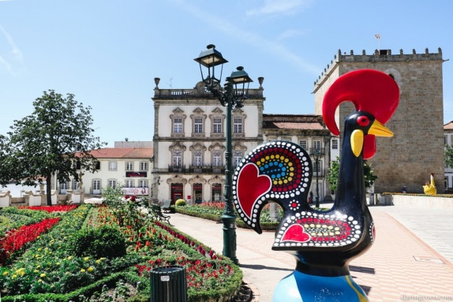

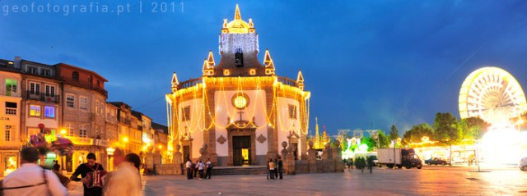
Barcelos
Our city:
Barcelos

Slide 16

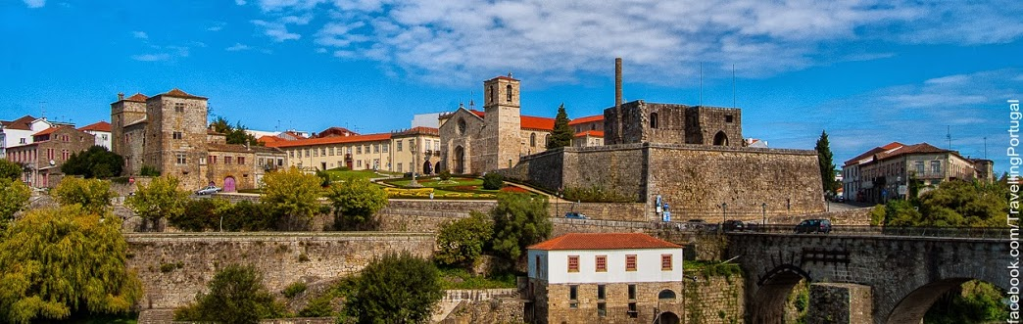
Barcelos in portugal
Barcelos is an historical city in the north of portugal (Braga District). It is located 15km away from the Atlantic Ocean
It is divided in 61 villages and it is home for about 120.391 people
The main symbol of the city is the “Rooster of Barcelos” which also represents Portugal and became famous worldwide

Slide 17
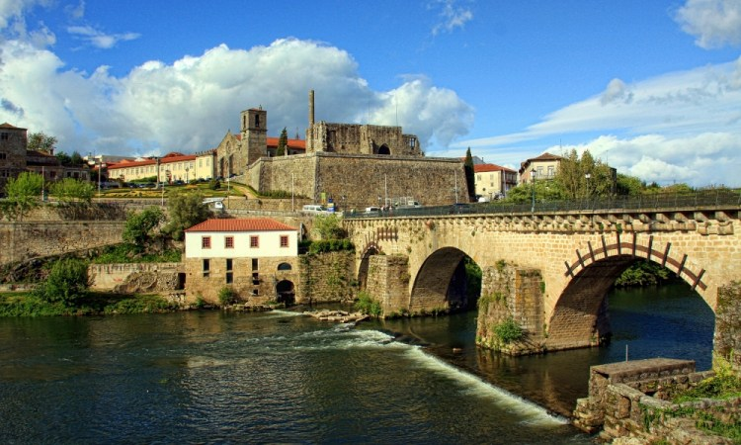
Why the rooster?
According to the myth, in the XVII century one innocent pilgrim was accused of stealing silver. Nevertheless, the authorities arrested the man and he was condemned to die.
Before being killed, he said to the judge, who was eating a roasted rooster, "It is as certain that I am innocent as it is certain that this rooster will sing when they hang me.”
While he was being hanged, the rooster sang,
proving the man’s innocence.

Slide 18
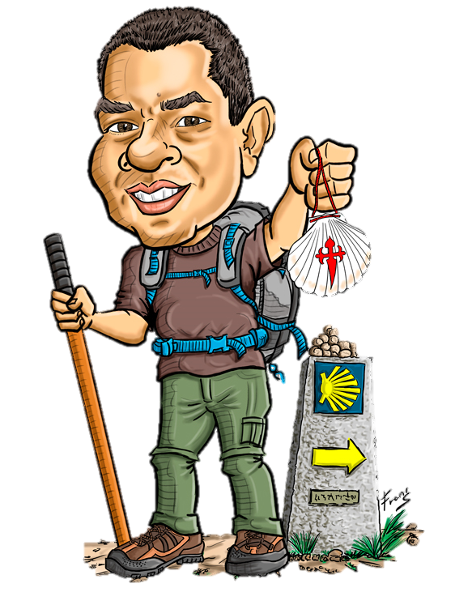
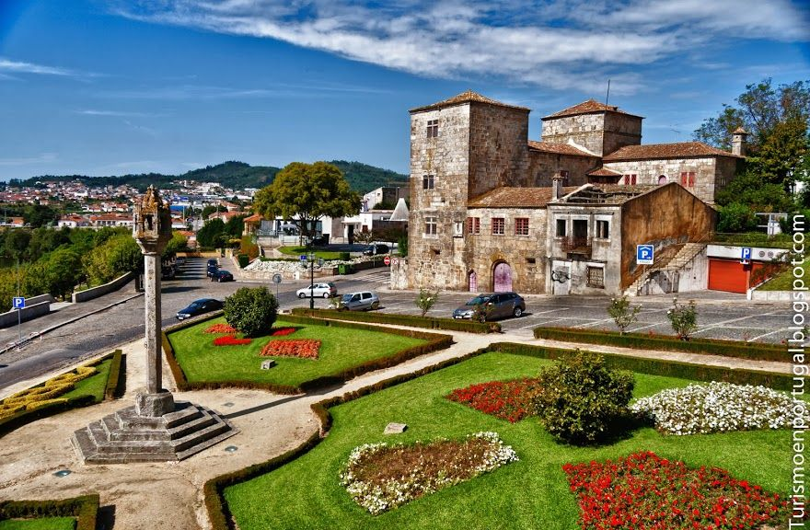
Tourism in Barcelos
Due to its quietness and jaw-dropping landscapes, Barcelos is an interesting place to visit. For this reason, the number of tourists have increased;
The Way of Saint James, the oldest
pilgrimage route in Europe, also helped the
development of the tourism
in this region.

Slide 19
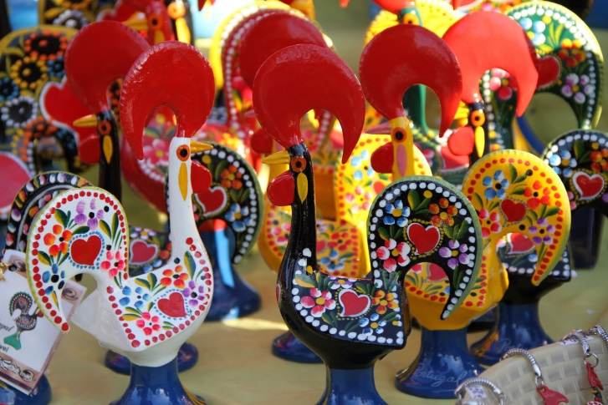
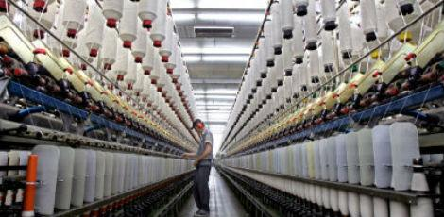
Mm
Handicraft and textile Industry
Barcelos is known for the handicraft and that’s why it is recognized as the Capital of Portuguese Handicraft
Of all the industries in the region, the textile ones are the majority, employing a large amount of residents. Thus, this sector is fundamental for the local economy.

Slide 20
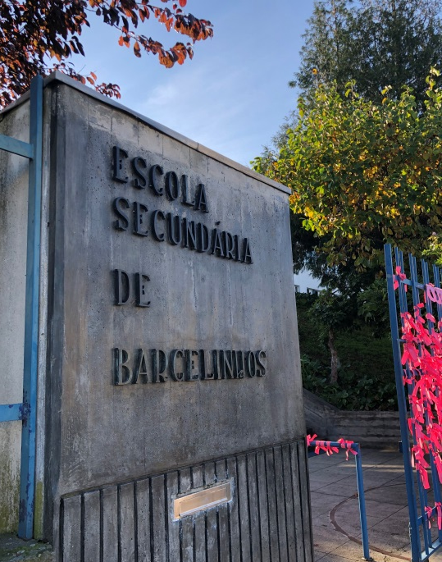
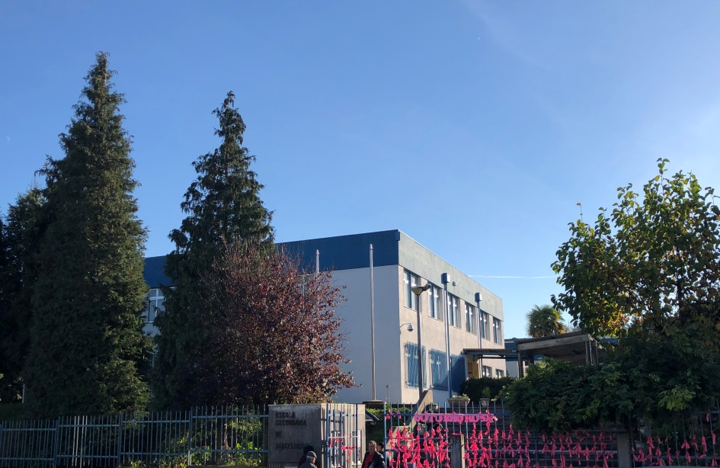
Our School:
Escola Secundária
de Barcelinhos
Established in 1986
640 students
Students aged from 11 to 18
On foot, it is approximately 10 minutes away from the city.

Slide 21

OBRIGADO!
Thank you!

Slide 22

Bibliography
www.eurostat.com
www.pordata.pt
www.saintjamesway.eu
www.cm-barcelos.pt
www.esbarcelinhos.pt

